Slide 1
CS 4530 & CS 5500
Software Engineering
Lecture 12.1: Engineering Software for Equity
© 2022, released under CC BY-SA

Slide 2
Learning Objectives for this Lesson
By the end of this lesson, you should be able to…
Suggest some ways in which software can cause inadvertent harm or amplify inequities, with examples
Explain why the software engineer has a powerful role to play in avoiding such harms.

Slide 3
SE @ Google Quote
As new as the field of software engineering is, we’re newer still at understanding the impact it has on underrepresented people and diverse societies. … We have had many public failures in protecting our most vulnerable users, and so we are writing this chapter because the path forward to more equitable products begins with evaluating our own failures and encouraging growth. We are also writing this chapter because of the increasing imbalance of power between those who make development decisions that impact the world and those who simply must accept and live with those decisions that sometimes disadvantage already marginalized communities globally.

Slide 4
Engineering Equitable Software
“One mark of an exceptional engineer is the ability to understand how products can advantage and disadvantage different groups of human beings. Engineers are expected to have technical aptitude, but they should also have the discernment to know when to build something and when not to."
-Demma Rodriguez, Head of Equity Engineering @ Google
Quote: “Software Engineering at Google: Lessons Learned from Programming Over Time,” Wright, Winters and Manshreck, 2020 (O’Reilly)
Notes:
This is a particularly important topic for a class on software engineering, as there is an enormous imbalance of power between those of us who make software development decisions, building software that’s used broadly, and the rest of the world that simply must accept and live with those decisions. Being an exceptional engineer means not only know HOW to build some killer features, but that you have the discernment to be able to identify and reject features or products that drive adverse outcomes. Most of you are preparing to become software engineers, and will likely wield more power than you realize.

Slide 5
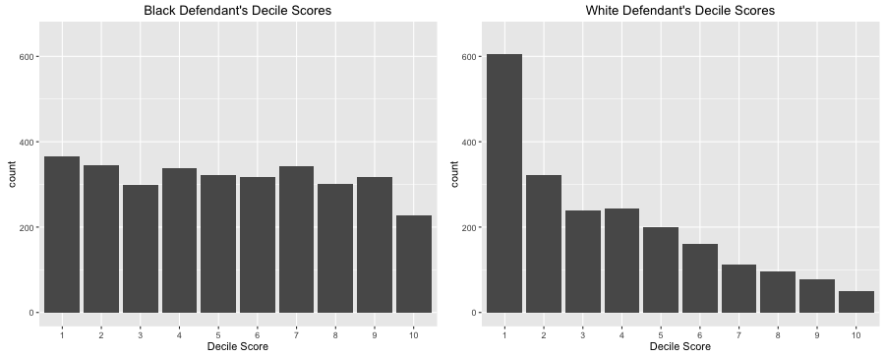
Algorithmic sentencing systems can discriminate against Black defendants
Example: the COMPAS Sentencing Tool
 | ALL DEFENDANTS | WHITE DEFENDANTS | BLACK DEFENDANTS
Labeled Higher Risk, But Didn’t Re-Offend | 32.4% | 23.5% | 44.9%
Labeled Lower Risk, Yet Did Re-Offend | 37.4% | 47.7% | 28.0%
Analysis of Broward County, FL data: “How We Analyzed the COMPAS Recidivism Algorithm” by Jeff Larson, Surya Mattu, Lauren Kirchner and Julia Angwin
Notes:
For example: some states use software to assess a criminal defendant’s likelihood of recidivism - a term used to describe criminals who are likely to re-offend. This prediction is used in pre-trial bail hearings, and also in sentencing, where the goal is to assign longer sentences to those most likely to commit another crime. It is likely not unreasonable to be concerned that some judges might be biased against certain defendants, and assign harsher sentences based on those biases. A machine-learning-based approach might eliminate this bias. When evaluating the model, the percentage of false positives and false negatives was roughly 30% in both ways (predicting higher risk, but didn’t re-offend or predicting lower risk, but did re-offend). However, if you break down this data by race, you can observe that white defendants are far more likely to be classified as lower risk (but re-offend) than they are to be classified as higher risk (and not re-offend). Black defendants, meanwhile, experience the opposite - being far more likely to be labeled as higher risk (and hence likely receiving a harsher sentence) even though they did not in fact re-offend. The scores that COMPAS assigns to defendants (high score means higher likelihood of recidivism) generally lean towards lower scores for white defendants and higher scores for black defendants. If computers can accurately predict which defendants are likely to commit new crimes, we could potentially reduce bias in our criminal justice system. However, when building such tools, it’s vital to evaluate them on multiple dimensions to ensure that we are not simply re-enforcing existing biases.

Slide 6
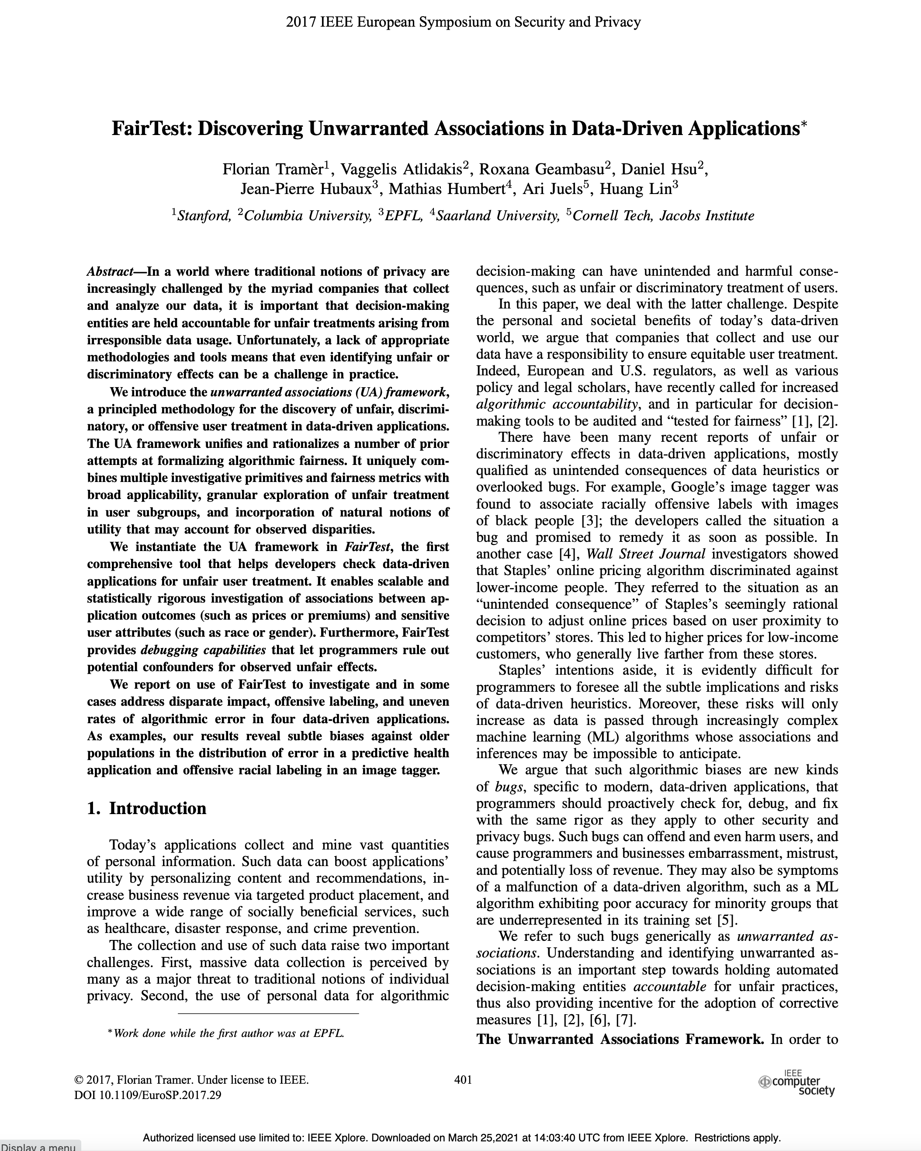
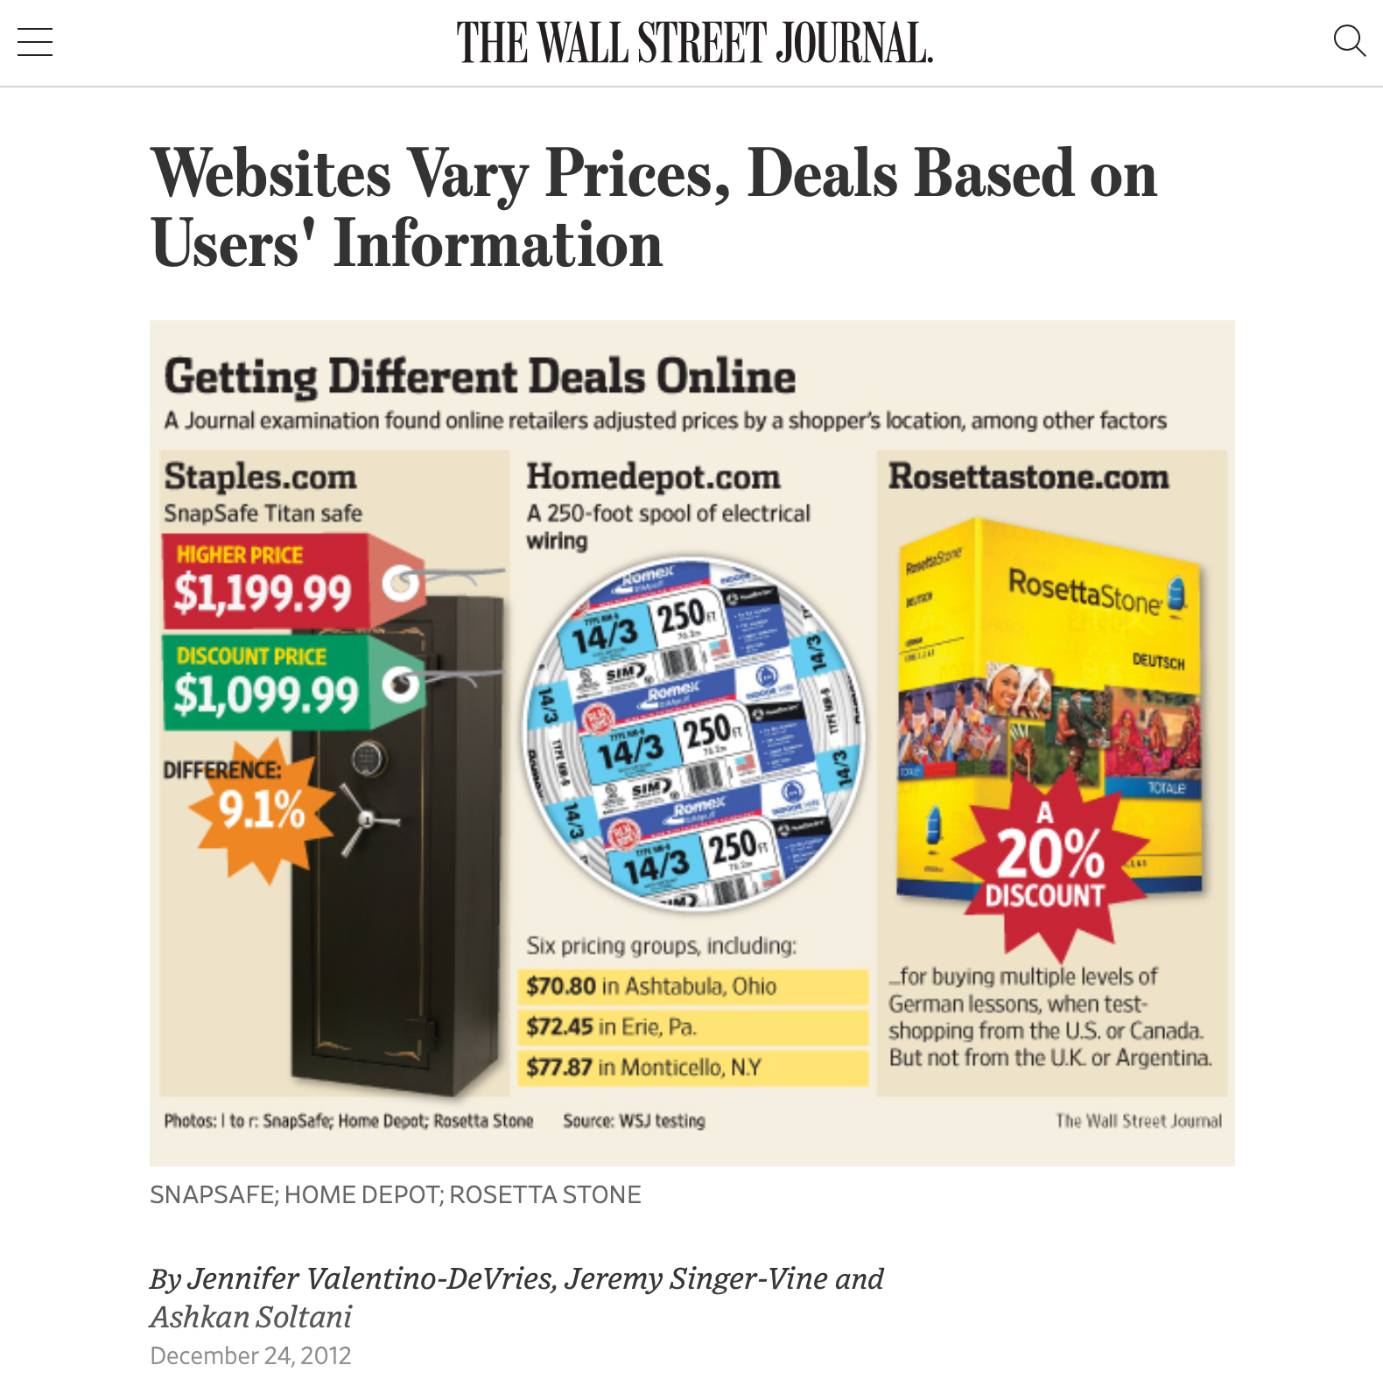
Algorithmic bias can discriminate against poorer consumers
https://www.wsj.com/articles/SB10001424127887323777204578189391813881534
Notes:
Algorithmic bias is all too easy to introduce - it is often easy to overlook hidden correlations between inputs that we feed into our algorithms and real world attributes. For instance: price discrimination and price steering are techniques that dynamically show a different price for the same good or service to different users. For example: Staples, OfficeMax and OfficeDepot compete to sell the same products to the same customers. If I’m Staples, and I’m trying to draw customers who might otherwise go to one of my competitors, I might say something like… “If you live within 20 miles of OfficeMax or OfficeDepot, you will see a cheaper price, otherwise you’ll see more.” This could let me drive revenues: customers who would have gone to a competitor see my low prices, customers who don’t have an alternative will pay the slightly higher price anyway. On the surface, this sounds fine. But: what if OfficeMax + OfficeDepot are primarily located in wealthy areas? If so, then our policy is actually saying: on the whole, charge wealthy customers less than poor customers. Whether this is an OK policy or not is a topic for a class on business ethics - what our interest as software engineers is is simply in recognizing that this could be an unintended harm.

Slide 7
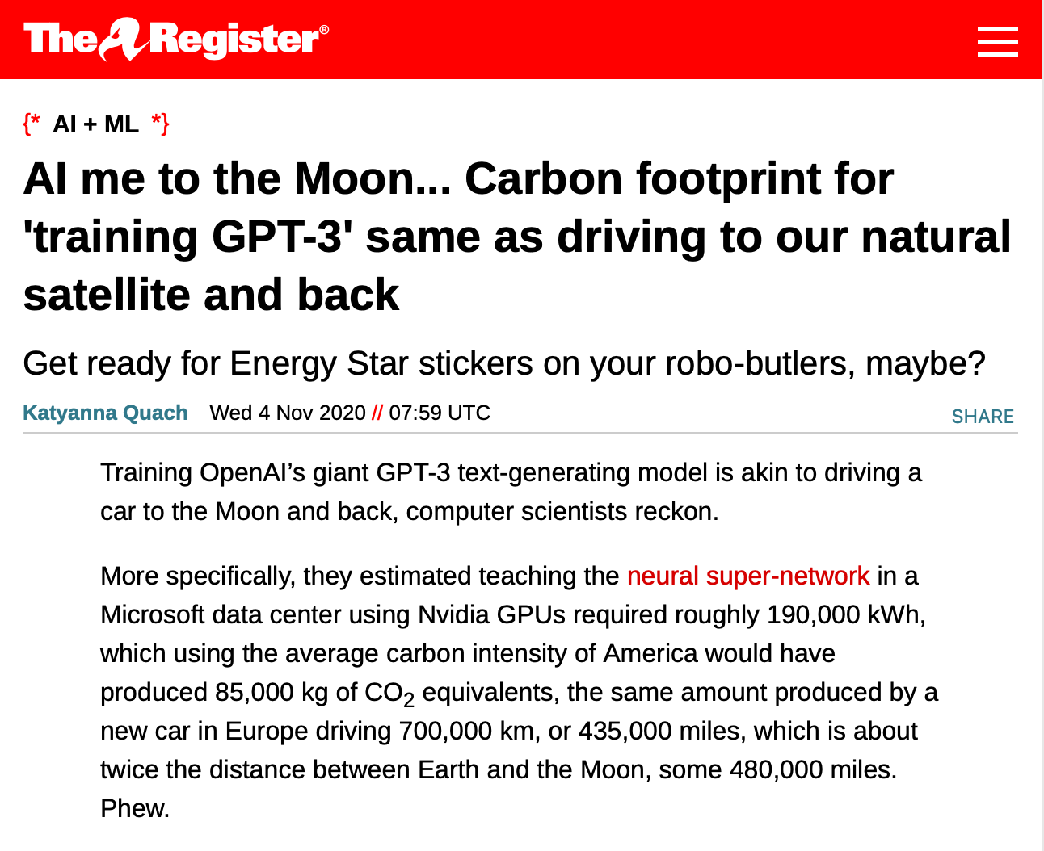
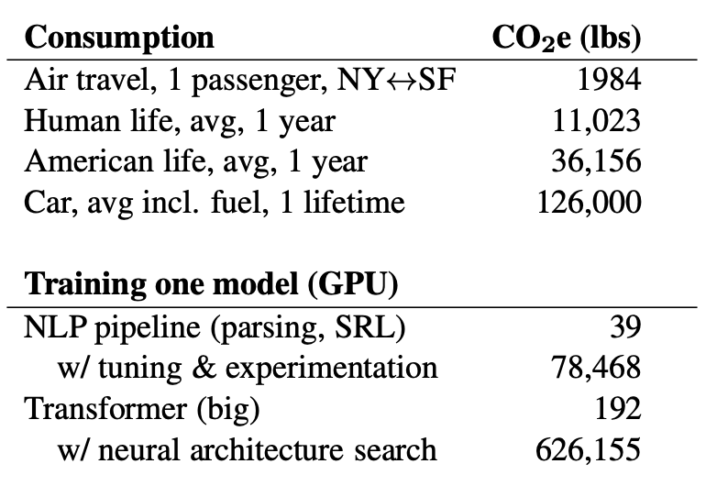
Training AI systems can have serious impacts on climate.
Did we mention bitcoin mining?
“Energy and Policy Considerations for Deep Learning in NLP” Emma Strubell, Ananya Ganesh, Andrew McCallum, in Proceedings of ACL 2019
https://www.theregister.com/2020/11/04/gpt3_carbon_footprint_estimate/
Notes:
As we build more and more complex software and in particular, machine learning models, it is also becoming increasingly important to quantify the climate impact of our software. For example, consider training GPT-3, which is the huge text-generation model that lets gmail/google docs auto-complete your sentences and write entire documents for you. The power consumption of the training process was equivalent to driving a car for 435,000 miles. Other studies have pointed out that in training and developing models, there’s often an even greater carbon impact. Again, this is not to say that we shouldn’t create machine learning models, but rather, simply to point out that this may be an unintended harm.
And Machine Learning is not the only application that uses huge amounts of energy (click)
Once we recognize the potential for harm, we can consider mitigation steps like locating our data centers in regions that provide for cheap renewable energy and cooling.

Slide 8
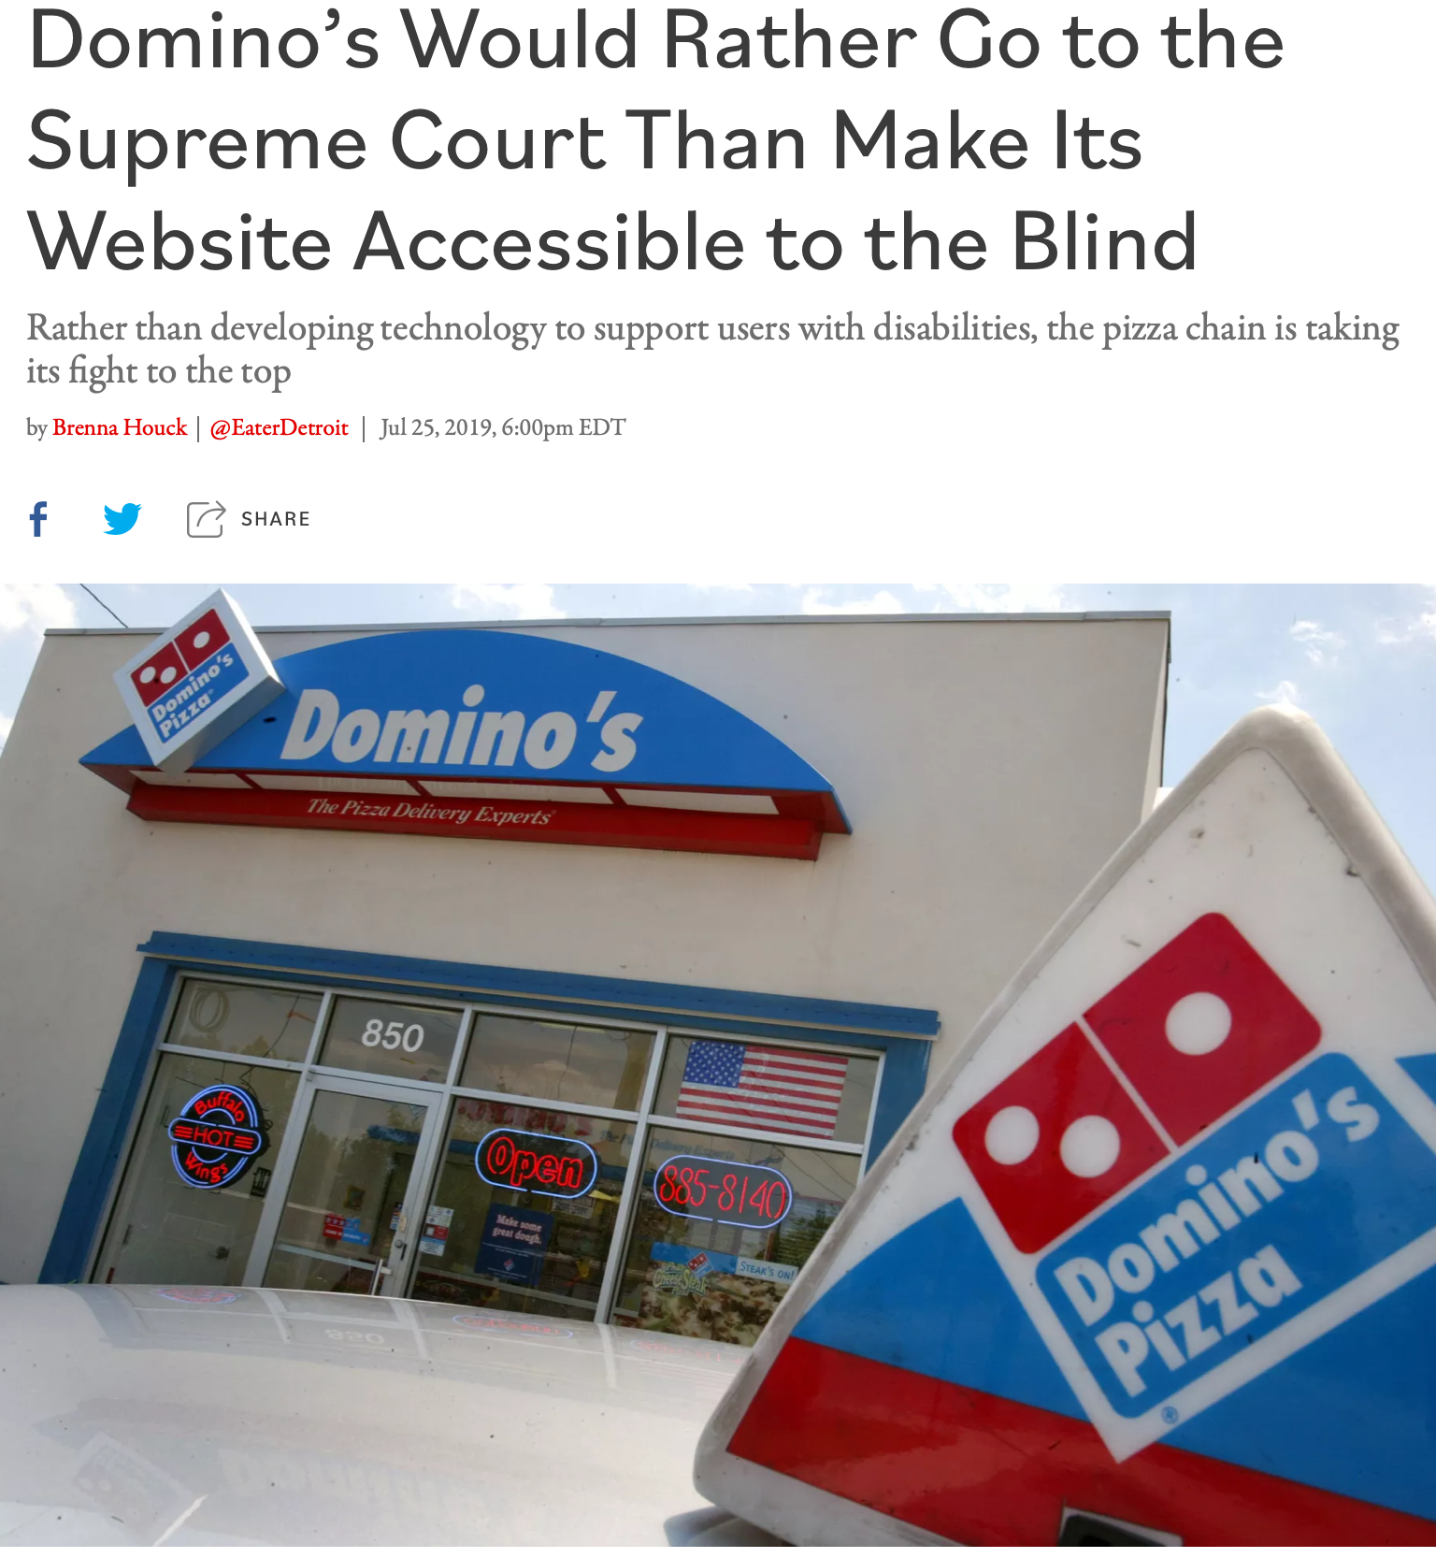
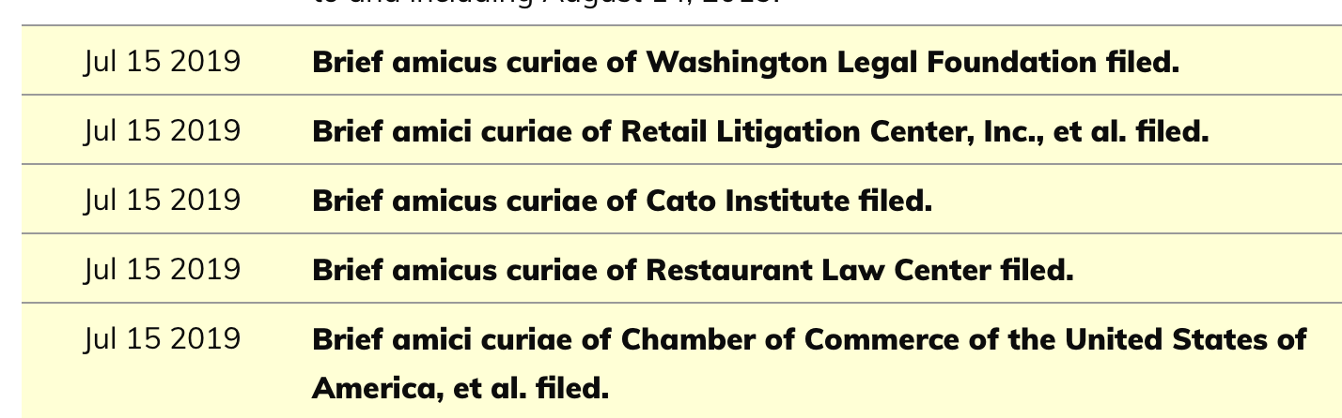
Poor user interfaces can discriminate against differently-abled people.
Inclusivity and Accessibility: Domino’s Pizza LLC v. Robles
“Domino’s Would Rather Go to the Supreme Court Than Make Its Website Accessible to the Blind” by Brenna Houck, Eater Detroit
Notes:
There are also very direct ways that we can inadvertently construct software that is not inclusive of all of our users. For instance: is our software accessible to users who have disabilities, such as being blind or low-vision? The Americans with Disabilities Act requires that public places must be accessible to people with disabilities. In 2019 a blind man sued Domino’s for not providing an interface for ordering pizza that was compatible with screen-readers, which is a kind of technology that is key to making computer accessible to the blind. Dominos argued that the ADA only applies to physical interactions, since it was written before Internet, so how are we supposed to know what an accessible website is? The question brought before the supreme court, was, basically: do online retailers need to provide an accessible website? Many within the retail and restaurant industries filed amicus briefs backing Domino’s, stressing the “impossibility of guessing what accessibility means in the online environment.” The supreme court found that the ADA applies to websites, too.
http://jlsp.law.columbia.edu/2020/02/13/inaccessible-pizza-delivery-and-the-future-of-the-ada/

Slide 9
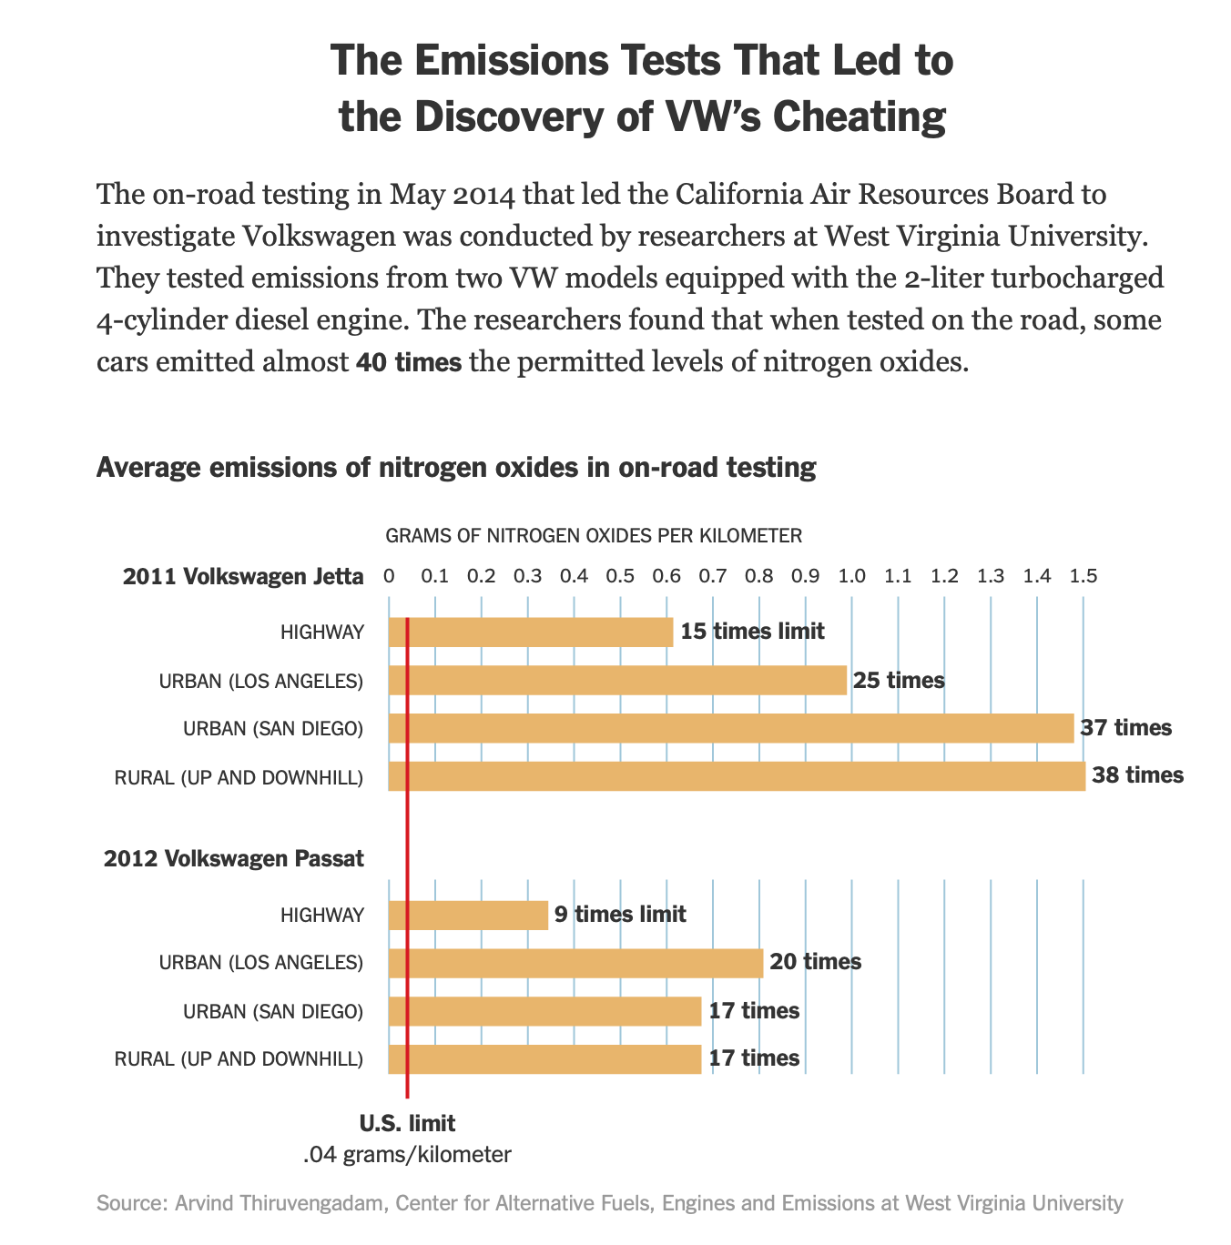
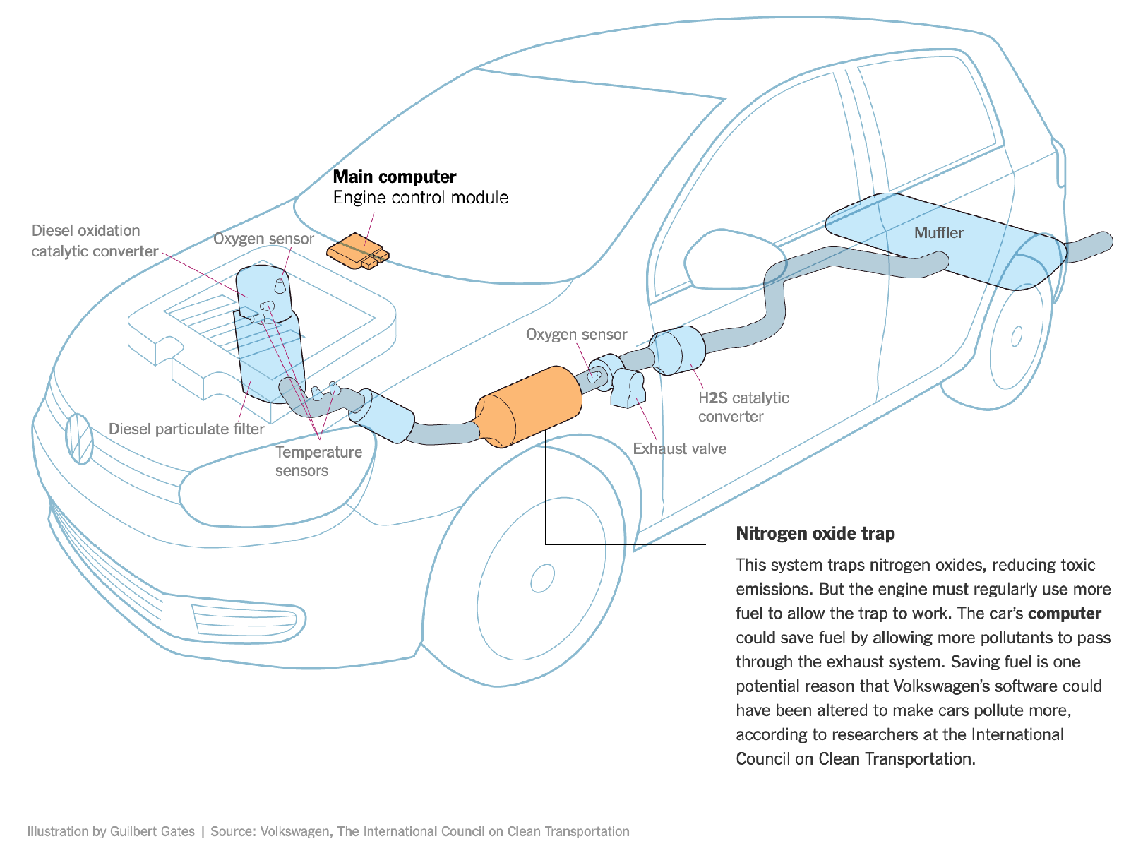
Software Systems can be used to evade regulation.
Example: Volkswagen diesel emissions
$14.7 billion settlement
“How Volkswagen’s ‘Defeat Devices’ Worked” By Guilbert Gates, Jack Ewing, Karl Russell and Derek Watkins
Notes:
It’s hard to talk about engineering equitable software and not bring up the Volkswagen emissions testing defeat device. If you’re not familiar with this scandal: cars are held to a particular emissions standard. Particularly in diesel cars, reducing emissions often tracks with reducing performance. Again, the question of “how much emissions are too much, if any” is out of scope for this discussion, and instead, we’re focusing on the regulations that existed at the time of this scandal. Cars are tested for this emissions standard in off-road simulators, where they can be easily hooked up to equipment that directly measures their emissions. Volkswagen’s engine control unit had customized software to detect when the car was under an emissions test and tune the engine to reduce performance and emissions, resulting in emissions tests that significantly under-represented the actual emissions of the vehicle. (Click) This software mislead regulators and consumers, and ultimately Volkswagen agreed to spend $14.7 billion in a settlement, and was subject to significant public relations damage.

Slide 10
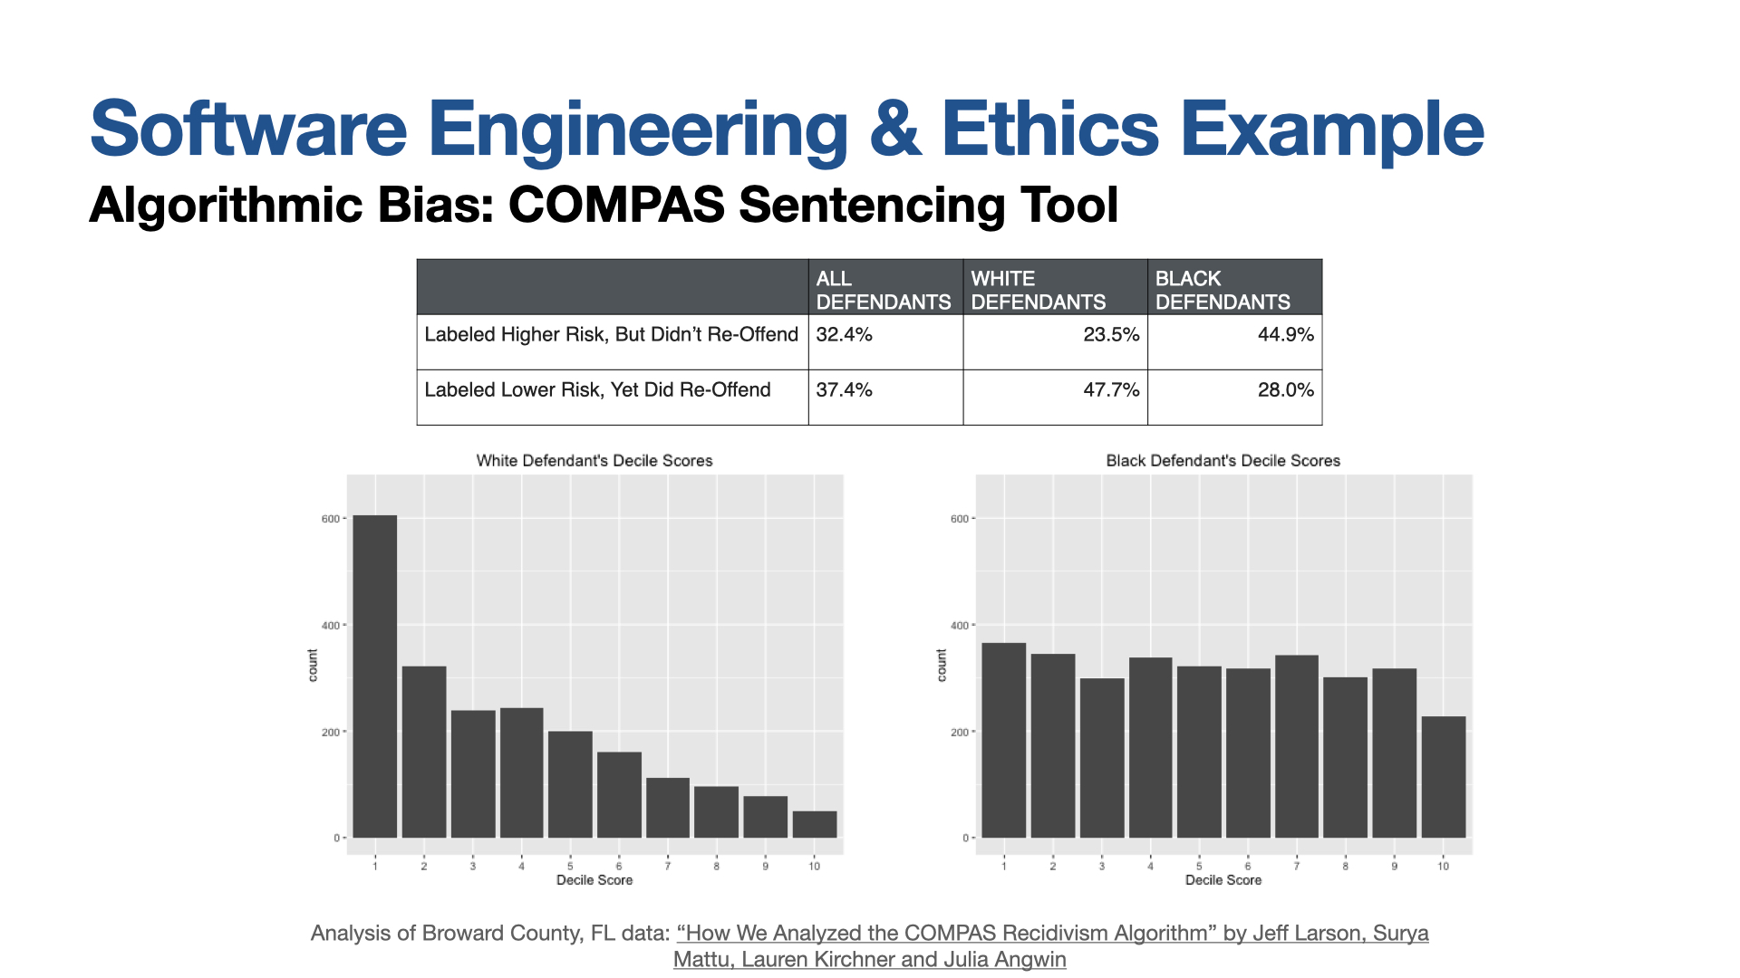
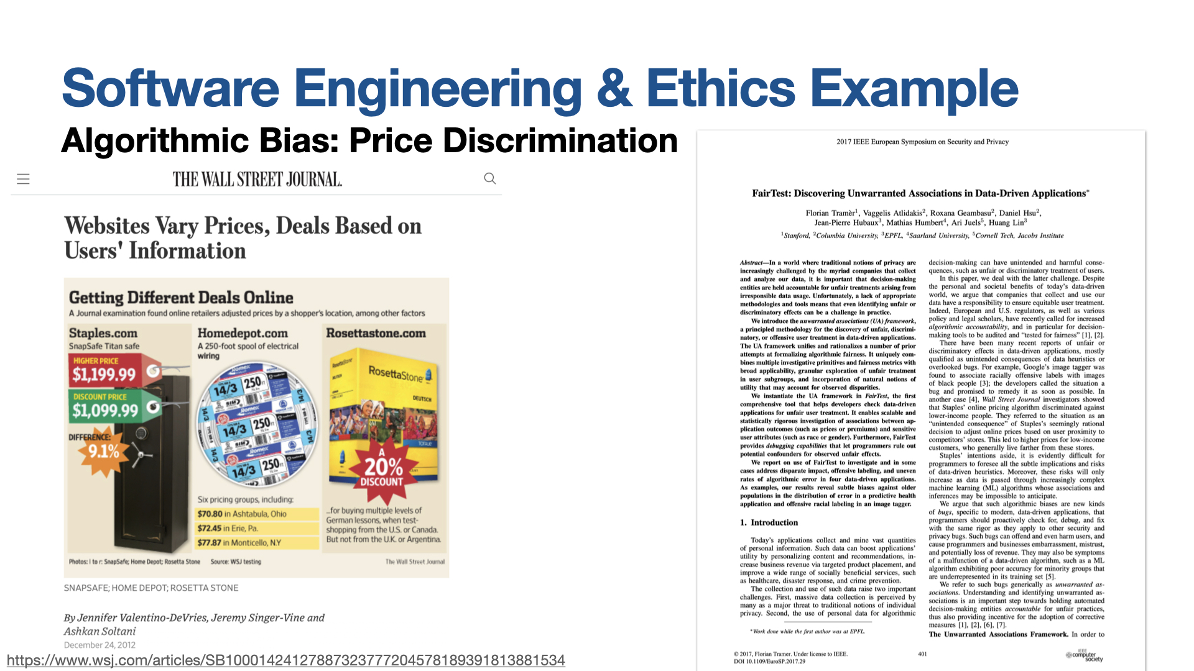
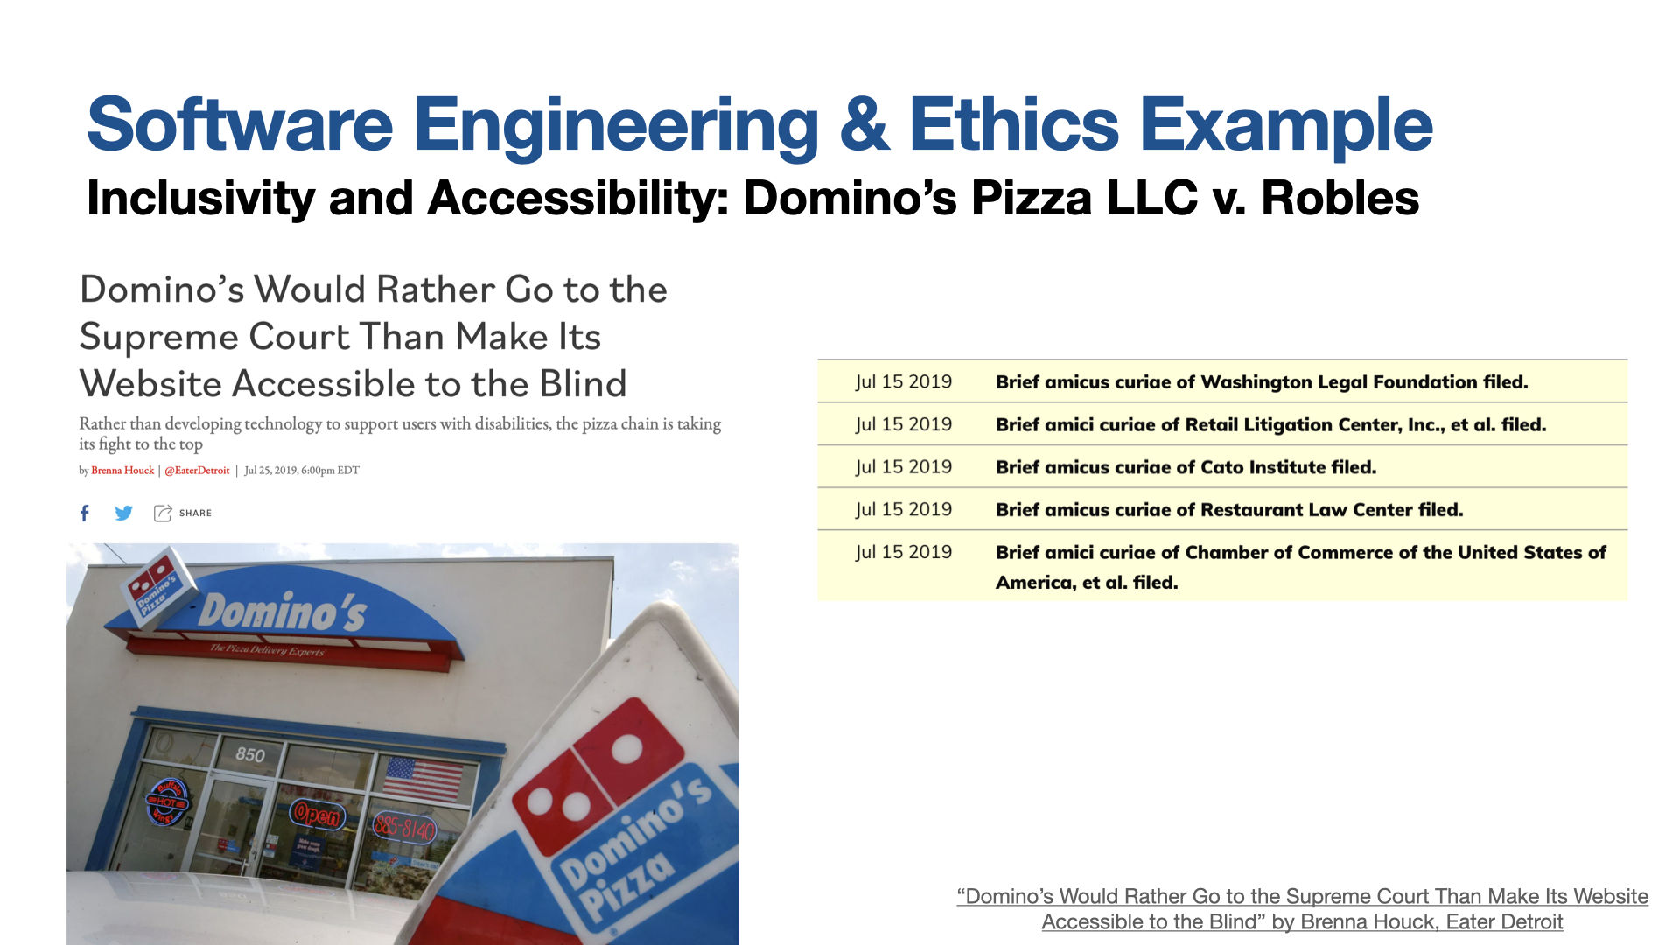
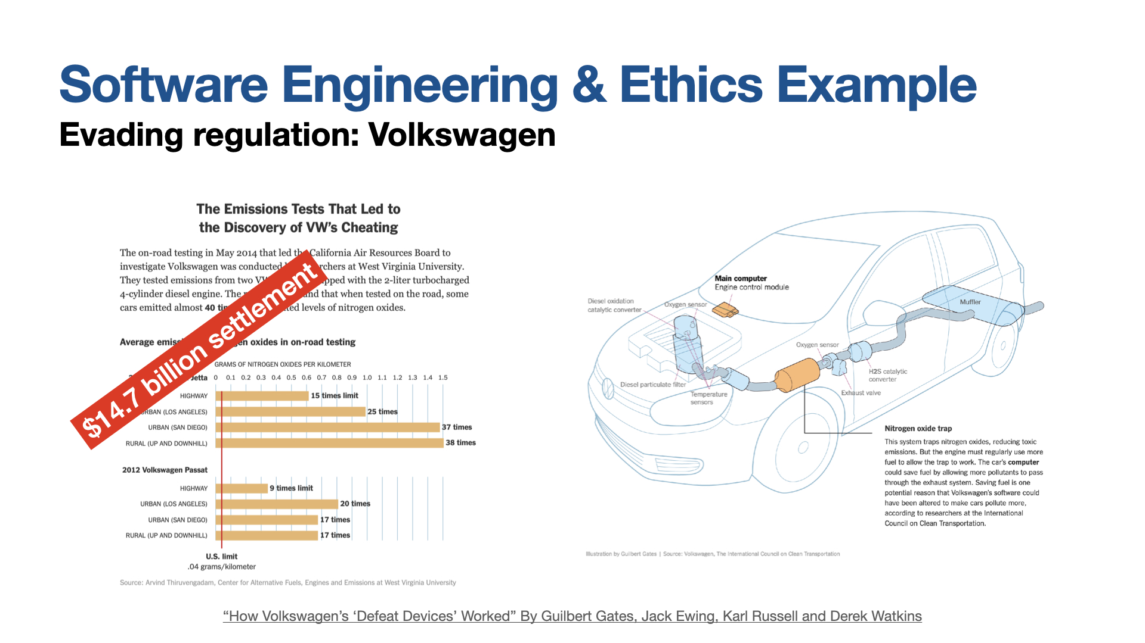
Reflecting on these examples
Personal philosophies and business cases
Notes:
Regardless of your personal ethical philosophy, and whether you think that it was OK or not for these companies to build these applications in these ways, I hope that we can all see a simple business case that argues for avoiding behaviors that will result in the kinds of negative public relations fiascos that these companies faced. Quite often when developing a product, we are faced with the choice of the fast option that provides inequitable outcomes. Sometimes, making our software equitable simply means an additional set of implementation tasks - like making the dominos app work with a screenreader. Other times, we may need to seriously examine the systems of inequality that our software is built on: how can we build a system to predict criminal recidivism if we acknowledge that the data that we base these models off of is inherently biased? Eventually these issues will come to light, quite likely ultimately come at a cost to your company, both in terms of PR and financial penalties, perhaps more so than if the right decision were made the first time

Slide 11
More than “don’t be evil”
Engineering equitable software requires conscious effort
How do we determine what “the right thing” is?
How do we convince our investors/managers to take this action?
Out of scope for this week: ethical frameworks (how do we reason between multiple compelling tradeoffs)
Notes:
Engineering equitable software requires conscious effort. It is not simple enough to take on a motto like “don’t be evil” or “do the right thing,” when it is often difficult to fully comprehend the societal impacts of our technical decisions. Moreover, even when we do see a clear potential harm to some portion of the population, taking corrective action can be challenging. In this lesson, we’ll discuss a few examples of unintended consequences or potential for harm that likely were overlooked in the development of the corresponding software. What is NOT in this week’s discussion are discussions of ethical frameworks and moral tradeoffs. For instance: Does Uber destroy local taxi industries, or does Uber create a new, working gig economy? Does AirBNB drive up rents, or does it provide much needed competition to major hotel chains? Does Facebook and Reddit drive community, or misinformation? These are very interesting questions, and we’ll leave them to ethicists, economists, and sociologists to study and answer.

Slide 12
This lesson was about the harms that software can inflict
You should now be able to…
Suggest some ways in which software can cause inadvertent harm or amplify inequities, with examples
Explain why the software engineer has a powerful role to play in avoiding such harms.

Slide 13
Engineering Software for Equity
This week’s roadmap
This lesson: What does it mean to build software that is equitable?
12.2: Ethics in Software Engineering
12.3: Acceptance & Inclusivity Testing
(not covered): How do we ensure an equitable experience for our diverse development team?
Notes:
After covering points on slide: Very related: How do we ensure an equitable experience for our diverse development team?

Slide 14
CS 4530 & CS 5500
Software Engineering
Lecture 12.2: Ethics in Software Engineering
© 2021, released under CC BY-SA

Slide 15
Learning Objectives for this Lesson
By the end of this lesson, you should be able to…
Articulate the ethical responsibilities of professional software engineers
List a set of questions that you can ask to evaluate the public impact of software

Slide 16
Professional Ethics
Professional standards
By 1675, standards established for: divinity, law, medicine
Professionals exercise specialist knowledge or skill - professional ethics governs how this knowledge should be governed
12th-century Byzantine manuscript of the Hippocratic Oath
Notes:
Before getting into ethics for software engineering, it’s useful to think about the origins of professional ethics. “Professionals” in this context generally refers to individuals who exercise some special knowledge that the public-at-large does not hold. When a professional provides services to a layperson, it is important for that layperson to be able to trust that they are not being taken advantage of. For example, the earliest instance of professional ethics is likely the hippocratic oath, which is rooted in doing no harm. Professional ethics standards exist for many different professions.

Slide 17
Code of Ethics
Professional Engineers
Engineers, in the fulfillment of their professional duties, shall:
Hold paramount the safety, health, and welfare of the public.
Perform services only in areas of their competence.
Issue public statements only in an objective and truthful manner.
Act for each employer or client as faithful agents or trustees.
Avoid deceptive acts.
Conduct themselves honorably, responsibly, ethically, and lawfully so as to enhance the honor, reputation, and usefulness of the profession.
National Society of Professional Engineers - Code of Ethics for Engineers
Notes:
Given that we’re talking about SOFTWARE engineering, it’s particularly useful to consider the closely related ethical problems that arise in civil engineering. Whereas it might be difficult to identify an immediate risk to life from a failure of most software, it is much easier to see how a miscalculation in the design of a building could result in the building to collapse, which would be catastrophic. Professional engineers are required to receive significant training in ethics to ensure that they understand the importance of, above all, ensuring the safety, health and welfare of the public. The building shown on this slide, the Citigroup tower in new york city, provides a particularly interesting case study of ethics in engineering.

Slide 18
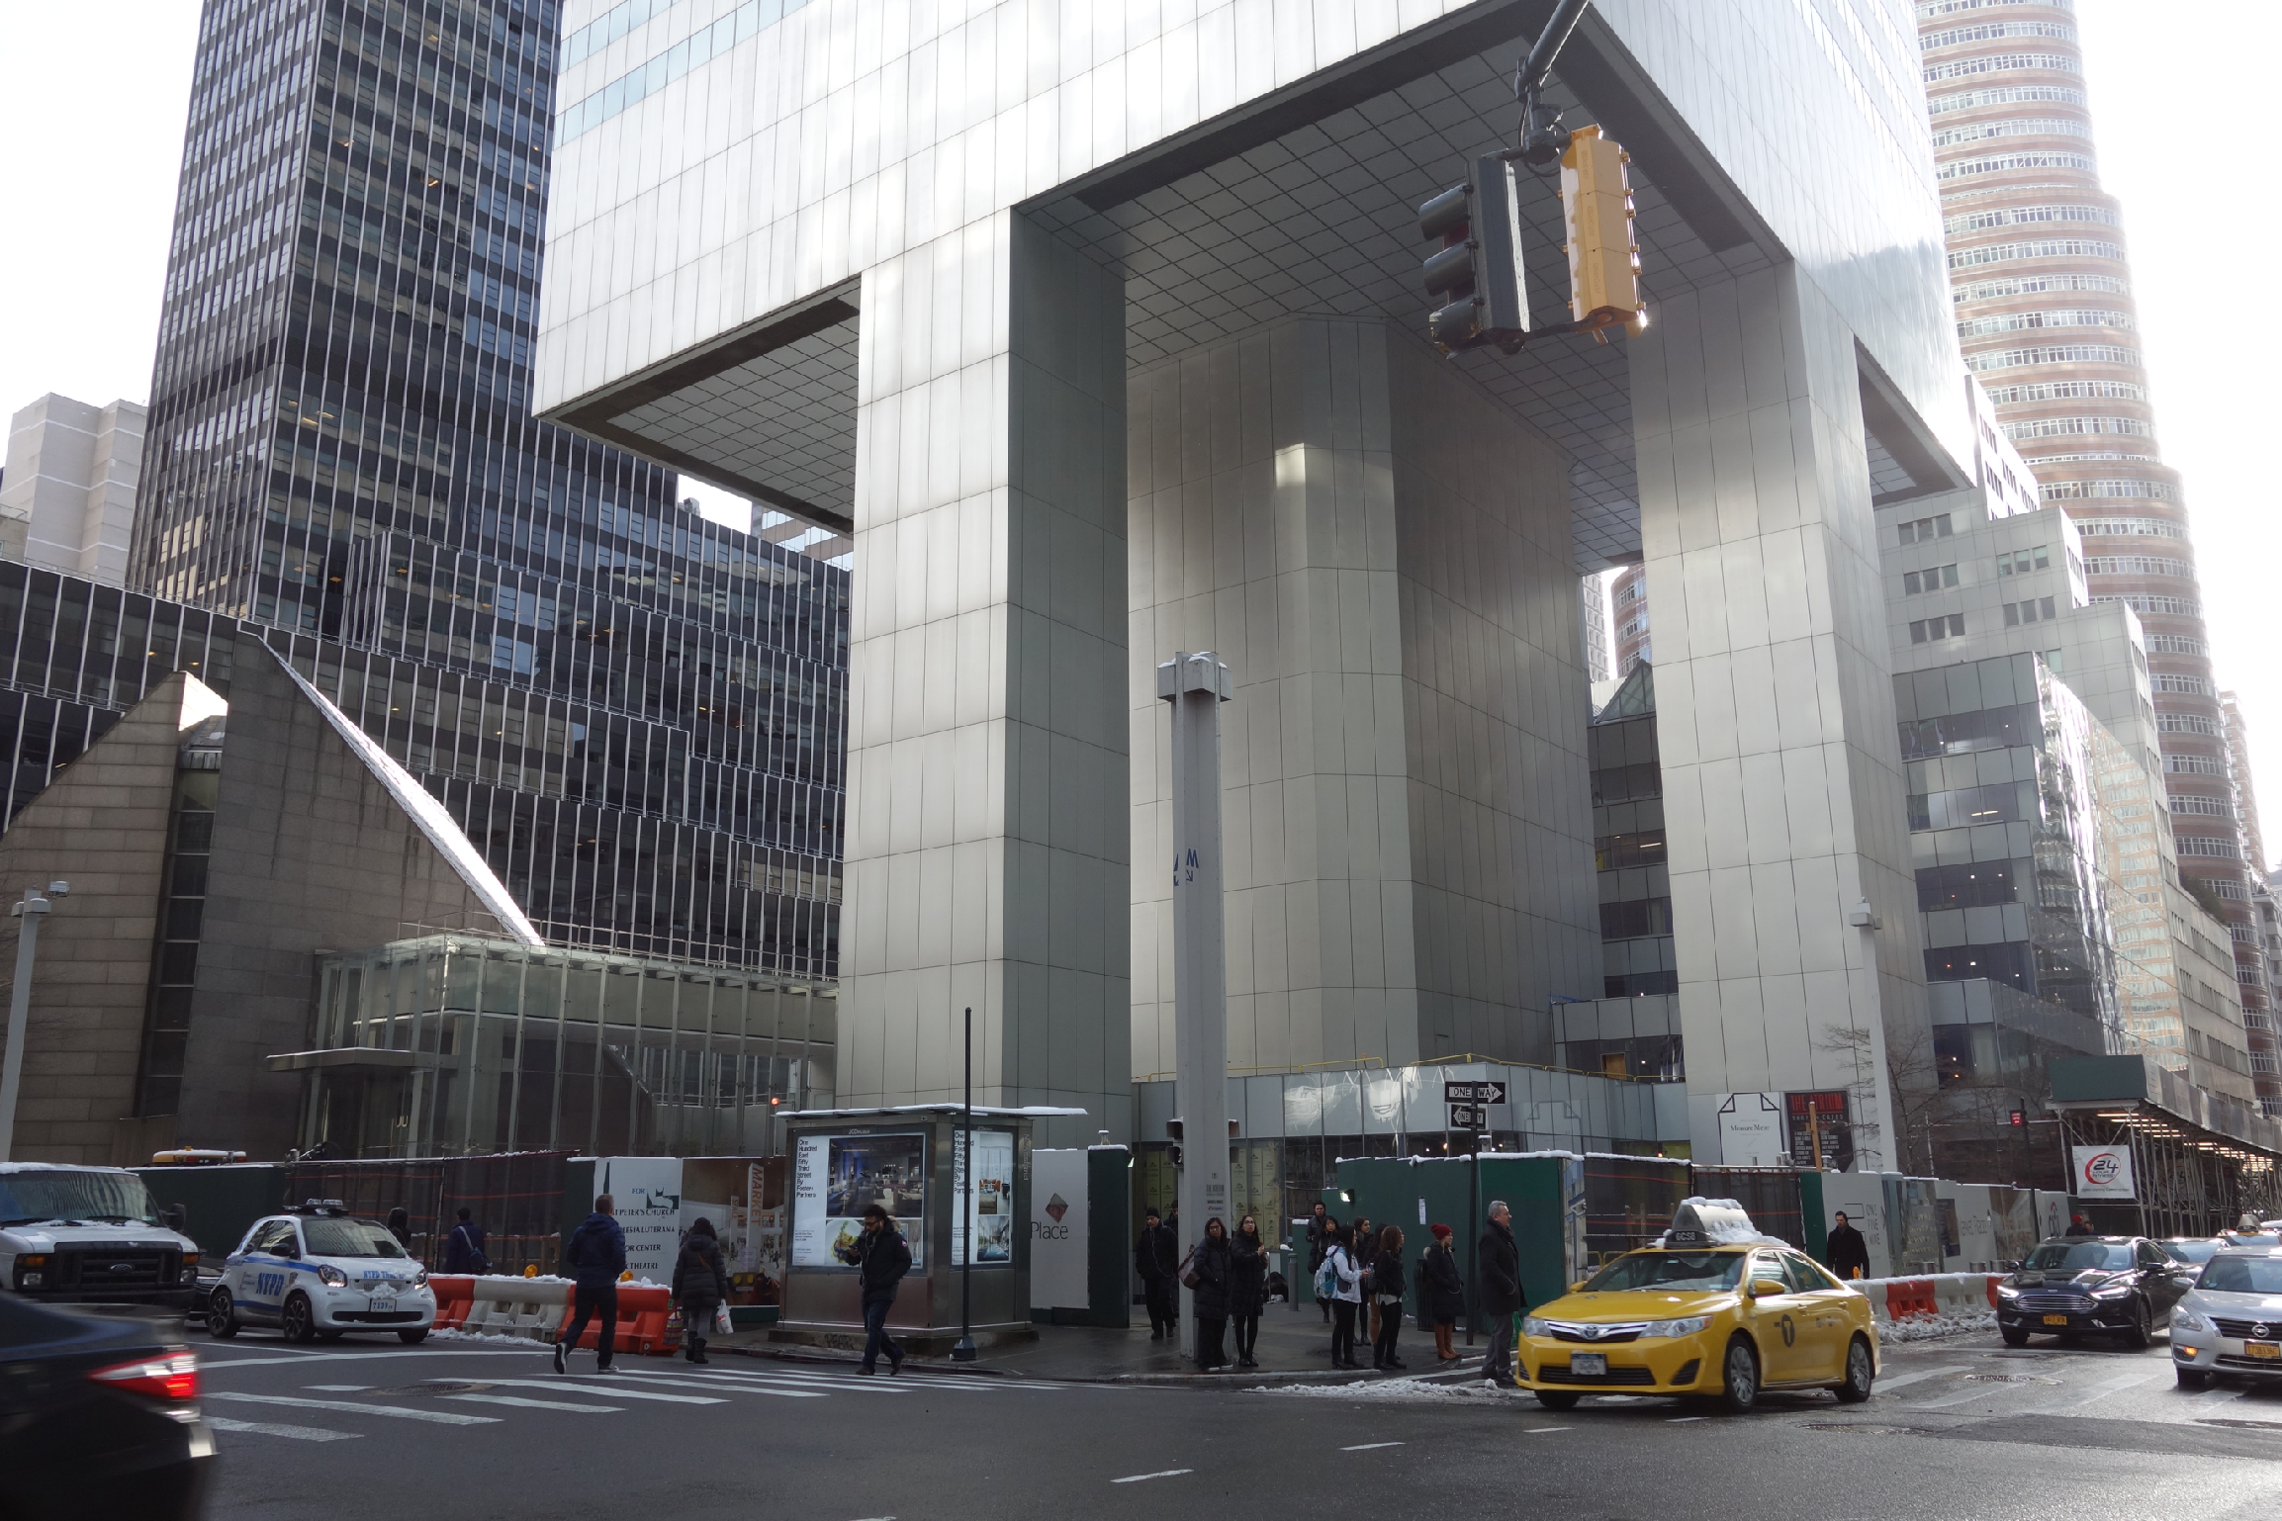
Code of Ethics
Professional Engineers: Citigroup Center
Design met building code, but did not account for all failure modes
Last-minute changes to construction increased odds of failure
Fixed before disaster could strike, but kept a secret for 20 years
https://www.theaiatrust.com/whitepapers/ethics/study.php
“Citigroup Center” by Tdorante10, Wikimedia commons, CC BY-SA 4.0
Notes:
Here’s a photo of the bottom of Citigroup Center, which was built 1974. It’s a very interesting building design: a 59 story tower cantilevered over a church - note this unique column architecture supporting the building. The engineer, LeMessurier, created a design that met building code (which in particular, required the design to be resilient to winds from N/S/E/W), but an analysis by an undergrad’s senior thesis found a diagonal hurricane-force wind would quite likely blow over the building. Usually face-on winds are the worst (for a building with columns on corners), but this building had columns in middle! Would have been OK if bottom joints were welded, but steel contractor wanted to bolt them to save millions of dollars, and was OKed. Fixed by the engineering firm, quite quickly, but also quietly. While being fixed added extra precautions to ensure safety and monitor weather, with evacuation plans. Kept secret for 20 years! This is a very interesting case study: note that the engineer did follow regulations, but still did not ensure safety in their design. Thankfully, the flaw was found by the student, and the engineering firm quickly took action to repair it, taking responsibility for the problem. One interesting discussion point here, however, is regarding how it was repaired - in secret! Do you think that this design flaw should have been made immediately public?

Slide 19
Badly-engineered software can kill people
Therac-25 (1985-1987)
Bug in software caused 100x greater exposure to radiation than intended
At least 6 died
Likely far more suffered: deaths occurred over a period of 2 years!
Weak accountability in manufacturer’s organization
“Therac-25” by Catalina Márquez, Wikimedia commons, CC BY-SA 4.0
https://ethicsunwrapped.utexas.edu/case-study/therac-25
Notes:
In contrast to the Citigroup tower case, where the engineering firm took responsibility for the failure and rectified it, let’s consider another classic professional ethics case, this one, from software engineering. A bug in the software controlling the THERAC-25 radiation treatment machine resulted in the death of at least 6 patients, and administered countless additional overdoses. Investigations after-the-fact found that the manufacturer had extremely poor software development and quality assurance processes, without independent code review, without testing, and without safety checks. The machine operators were assured that overdoses were impossible - software was reused from older machines which had hardware interlocks to prevent these software defects from being catastrophic. Note that one result of this incident is stronger standards for safety-critical (in particular: medical) software, which now require rigorous quality assurance practices. The manufacturer of the machine, however, could have easily prevented further damage had they immediately detected and resolved the bug after the first reported incident in 1985.

Slide 20
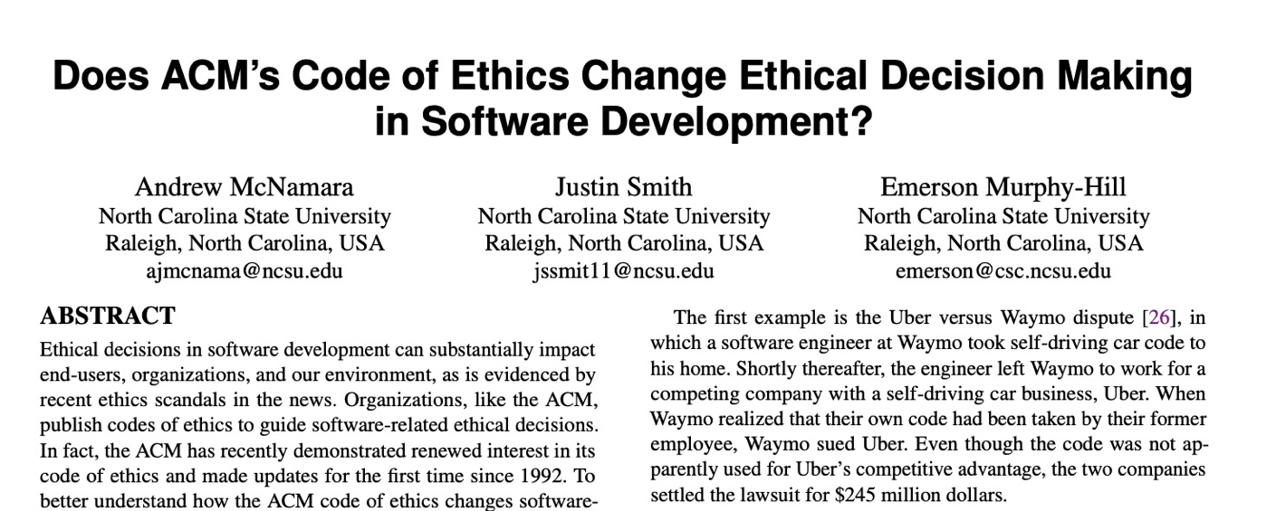

Code of Ethics
ACM’s Code of Ethics Software Engineers
tldr: “No”
1. PUBLIC – Software engineers shall act consistently with the public interest.
2. CLIENT AND EMPLOYER – Software engineers shall act in a manner that is in the best interests of their client and employer consistent with the public interest.
3. PRODUCT – Software engineers shall ensure that their products and related modifications meet the highest professional standards possible.
4. JUDGMENT – Software engineers shall maintain integrity and independence in their professional judgment.
5. MANAGEMENT – Software engineering managers and leaders shall subscribe to and promote an ethical approach to the management of software development and maintenance.
6. PROFESSION – Software engineers shall advance the integrity and reputation of the profession consistent with the public interest.
7. COLLEAGUES – Software engineers shall be fair to and supportive of their colleagues.
8. SELF – Software engineers shall participate in lifelong learning regarding the practice of their profession and shall promote an ethical approach to the practice of the profession.
1. PUBLIC – Software engineers shall act consistently with the public interest.
https://ethics.acm.org/code-of-ethics/software-engineering-code/
Notes:
Software Engineers are not legally held to any code of ethics, and unlike many other professionals (like lawyers, doctors, and civil engineers), we are not licensed by a professional society who holds us to ethical standards. Nonetheless, the ACM, one of the largest professional societies for computer scientists, has established a code of ethics for software engineers. This code is quite similar to those for professional engineers, and includes as the first tenet, (click) that software engineers should act consistently with the public interest - both doing no harm to the public, and hopefully doing good.
Studies have investigated whether simply exposing engineers to this code of ethics improves ethical decision making in software development
(Click)
(click),
concluding that this code alone does not improve ethical decision making.
Making ethical decisions often involve weighing multiple trade-offs: in the case of the Citigroup tower, the engineering firm (and their client, and their insurer) had to make a difficult ethical choice: should they immediately publicly disclose the fact that a strong wind could topple the tower - clearly a concern in the public interest, or should they instead prepare with officials to perform an emergency evacuation and monitor the weather closely without informing the public about the potential hazard (which could provoke unnecessary panic)? A code of ethics alone does not give sufficient guidance.

Slide 21

Safety-Critical Software Regulations
Standards for Software Development
International bodies define standard processes that are designed to protect the public
By (correctly) following such a standard, you can reduce the chance of harm to users, as well as your ethical (and legal) liability
Notes:
Areas where there are well-defined standards give the engineer more concrete guidance. For example, companies constructing medical device software must now comply with well-defined standard processes for developing that software in a way that will assure safety. Simply following the standard doesn’t guarantee safety, but doing so can help to ensure that it does, while also reducing our legal and moral liabilities. Similarly, software for aircraft must pass through a rigorous process.

Slide 22
Unpacking “Public Interest”
1. PUBLIC – Software engineers shall act consistently with the public interest.
Do no harm: how can our software cause harm?
How can my software fail? What are the implications of that failure?
Who will use my software, and how might different users use it differently?
How will my software impact those who do not use it directly?
Will my software amplify negative behavior for users and society at large?
Notes:
So, when considering that we want to do no harm to the public interest, we might consider asking ourselves questions like this:
If there’s a bug in my software, what could be the resulting impact? What parts of my software will be most likely to have negative human impacts if buggy, and how do we test that part most effectively?
Who will be the users of my software, and will it impact different users in different ways? Will my software disadvantage some users?
Will there be a negative impact on people who do NOT use my software, for instance through climate, or through social forces?

Slide 23
Unpacking “Public Interest”
How can our software make a positive contribution?
Can my software make people’s jobs easier?
Can my software make people happier?
Can my software amplify positive behavior for users and society at large?
How can my software better achieve these goals?
Notes:
Similarly, when we are trying to become excited about some software project and its potential for good, we might think about the potential for our software to make people’s jobs easier and make people happier, broadly amplifying positive behavior for our users and the general public.
If we identify these goals, we can evaluate them as part of our software quality process

Slide 24
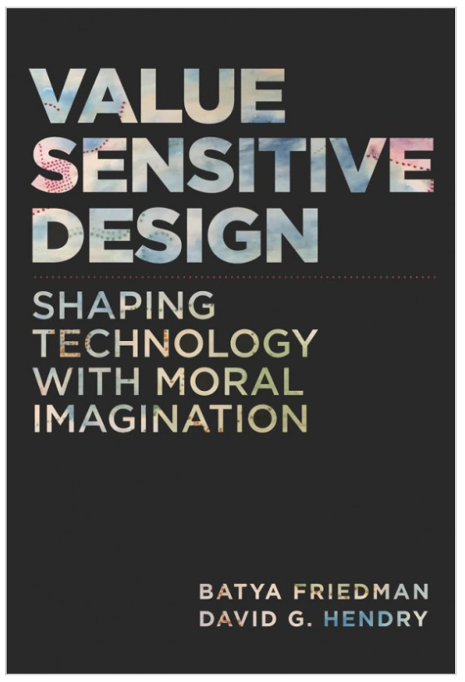
Unpacking “Public Interest”
What values might our software promote or diminish [partial list]
Human rights - Inalienable, fundamental rights to which all people are entitled
Accessibility - Making all people successful users of the technology
Justice - Procedural justice (process is fair) + distributive justice (outcomes are fair)
Privacy - An individual’s agency in determining what information about them is shared
Human welfare - Physical, material and psychological well-being
Value Sensitive Design @ Khoury
Notes:
Value-sensitive design is an approach to guide the design of technology while considering the impact of the technology on a variety of core human values. This approach can help us to identify unintended consequences of our software, which we can then begin to reason about.
Core values include human rights, accessibility, justice, privacy and human welfare, and many others.
As we think about the software that we’re building, we can ask ourselves explicitly: how does our software impact these values?

Slide 25
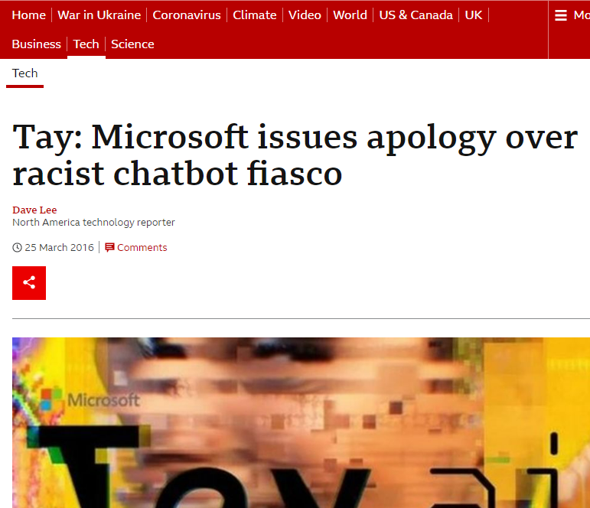
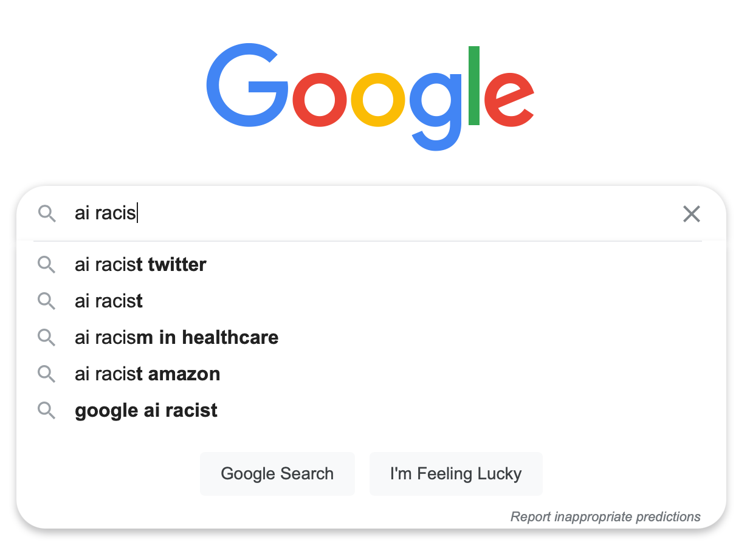
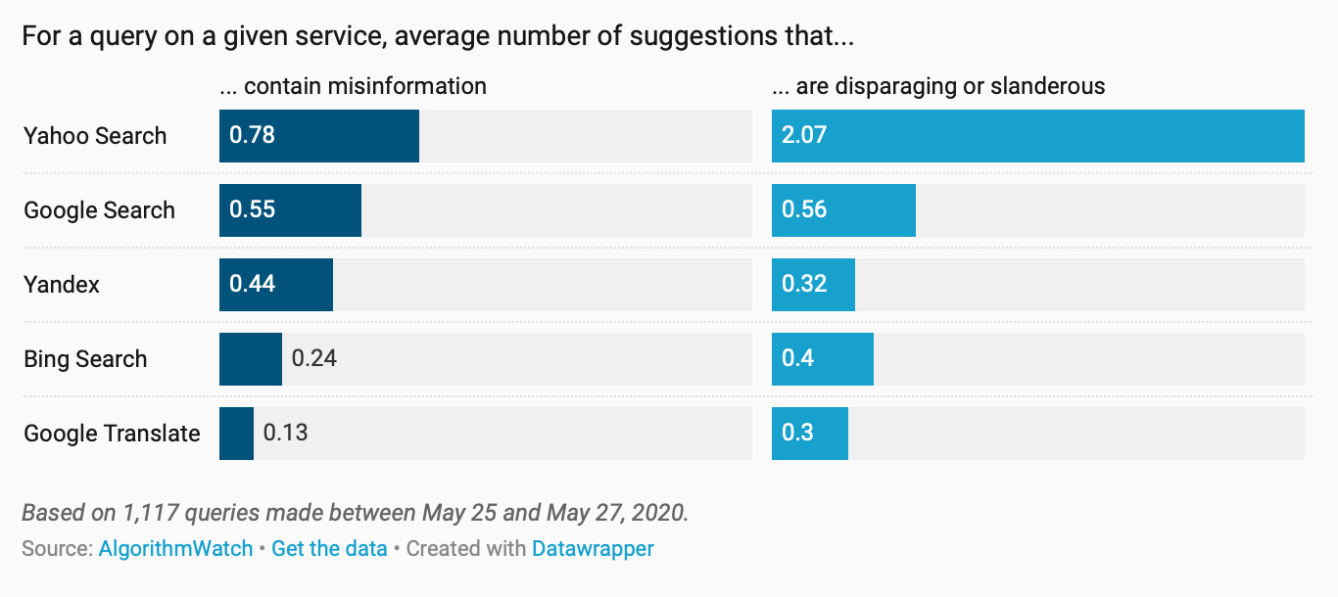
Ethical decisions are often hard decisions
Example: Text Recommendation
Interactive AI systems can be useful
Interactive AI systems can also amplify hate
Ethical and moral frameworks provide a lens to make rational decisions
“Ten years on, search auto-complete still suggests slander and disinformation”
Notes:
In a software engineering scenario, we might consider the ethical issues surrounding text recommendation. On one hand, interactive AI systems can be useful - for instance, providing suggestions to auto-complete search terms. However, at the same time, these systems can amplify hate - a small population of motivated users can coerce these models into providing disparaging or slanderous recommendations. Yet, there is a scientific value to developing such technologies. Ethical frameworks can help balance tradeoffs like this and are the topic for another class.

Slide 26
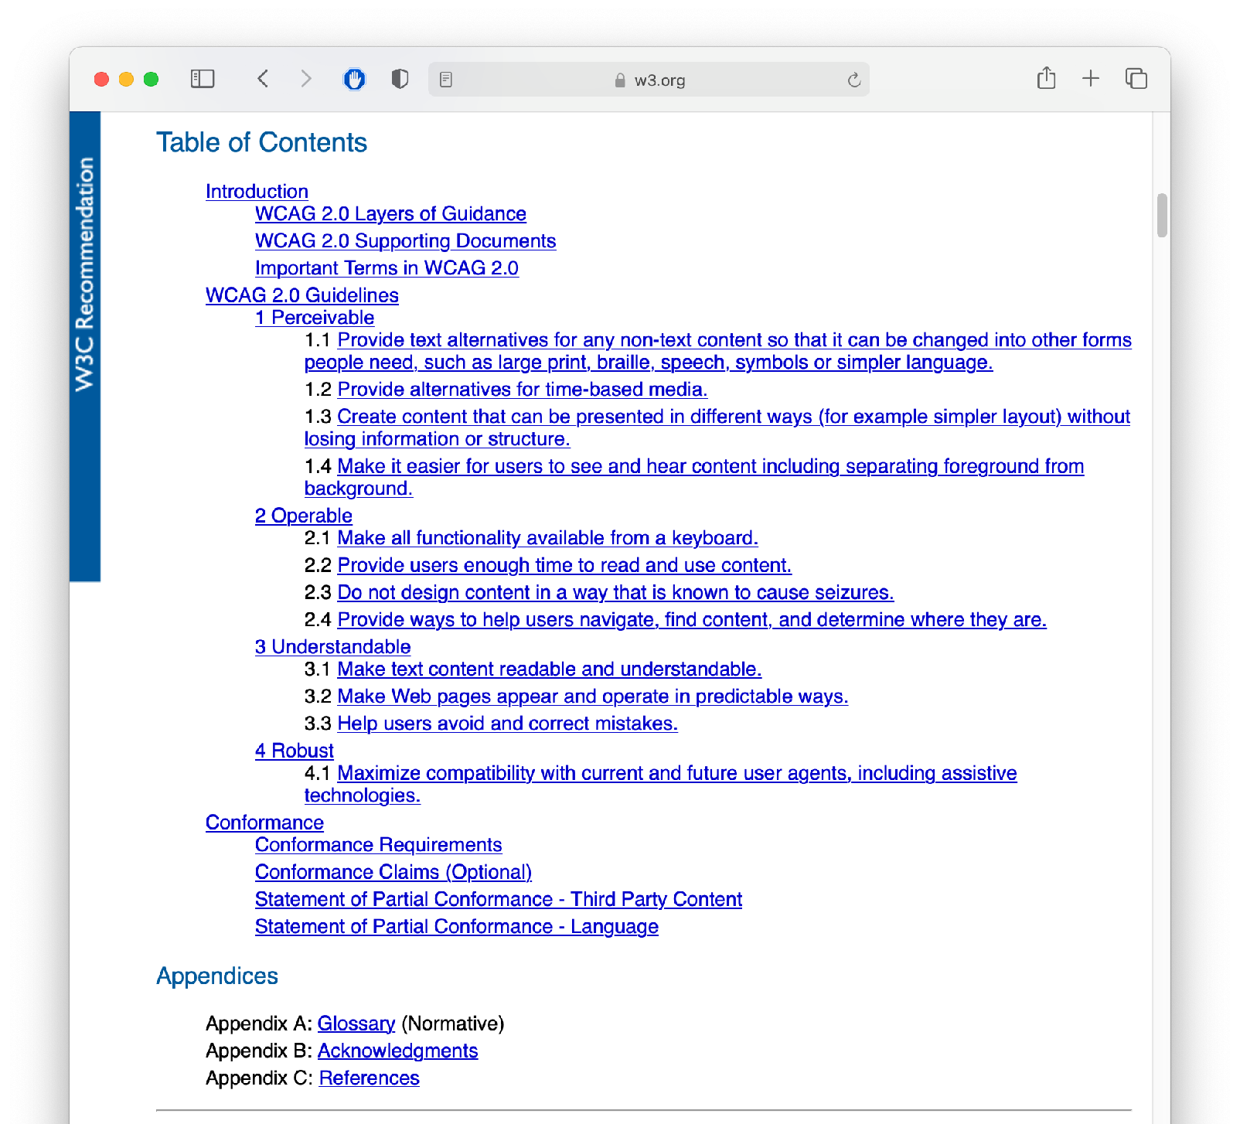
Accessibility should not be a hard decision
Example: Domino’s + ADA
WCAG 2.0 Specification
Notes:
Again, our focus is on identifying ways that the software that we engineer is or is not inclusive, and generally “good” - in ways that are hopefully more clear. For example, the case of Domino’s unwillingness to comply with the ADA and provide an accessible pizza online pizza ordering interface was a direct statement that Domino’s did not want to sell pizza online to blind customers. In court documents, Domino’s revealed it would have cost just $38,000 to resolve the raised accessibility issue (surely they would have made that back in pizza sales, or at least, would not have spent far more than that in legal fees). There was a standard that could have been followed.

Slide 27
Where does this leave us?
So that we can sleep at night
Above all: try to do good - consider the impacts of your software on others
Follow best-practices, and actively push to improve them
Next lesson: How do we understand our users, so that we can make the best software, and cause the least unintended harm?
Notes:
There’s no silver bullet for ethical software development. However, hopefully now you understand better the different ways that our software can have impacts on others, and how we can reason about those implications. The next and final lesson in this module will examine how we can better understand our users, so that we can make the best, most inclusive software, and in turn, hopefully cause the least unintended harm.

Slide 28
CS 4530 & CS 5500
Software Engineering
Lecture 12.3: Acceptance and Inclusivity Testing
© 2021, released under CC BY-SA

Slide 29
Learning Objectives for this Lesson
By the end of this lesson, you should be able to…
Explain ways in which developers of software often differ from the users of that software, introducing potential inclusivity bugs
Recognize persona-based cognitive walk-throughs as an approach to help put yourself in someone else’s shoes

Slide 30
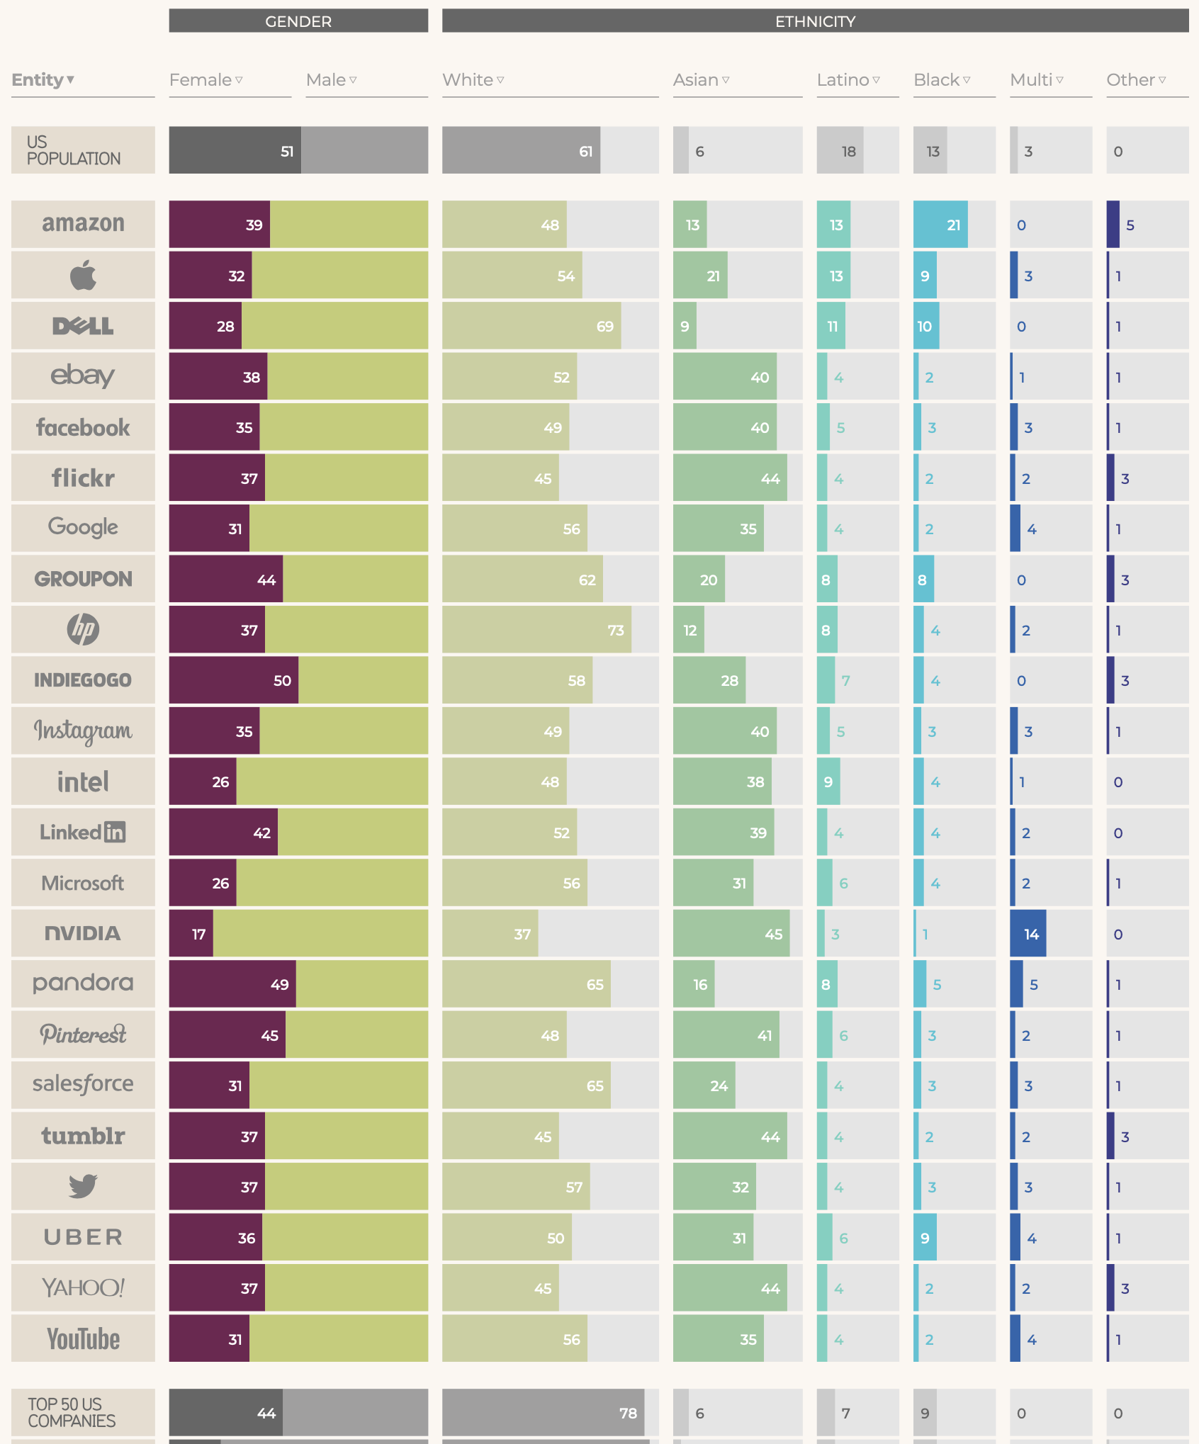
We are not our users
Data from 2017
Creating inclusive software requires us to acknowledge that we differ from our users
Our quality assurance is only as good as we can understand our users
https://informationisbeautiful.net/visualizations/diversity-in-tech/
Notes:
Our goal in this lesson is to explore approaches to detect equity and inclusivity bugs in software. How do we start? First, it is vital that we recognize that we each bring our own biases of how we expect our software to be used. Developers may differ from users in: nationality, ethnicity, race, gender, age, socioeconomic status, abilities, and belief systems. Creating inclusive software requires us to acknowledge these differences. Having diversity on your development team is one of the first steps towards creating inclusive software. However, attracting and retaining a diverse team is its own topic - this infographic shows the relative lack of diversity at top US-based tech firms, in comparison to the population of the US - teams often lack diversity in gender and ethnicity - and simplifying diversity to only gender and ethnicity can overlook other facets of how we vary. In this lesson, we’ll focus on approaches to better understand our users, and to evaluate whether our software is inclusive, usable, and accessible, or not.

Slide 31
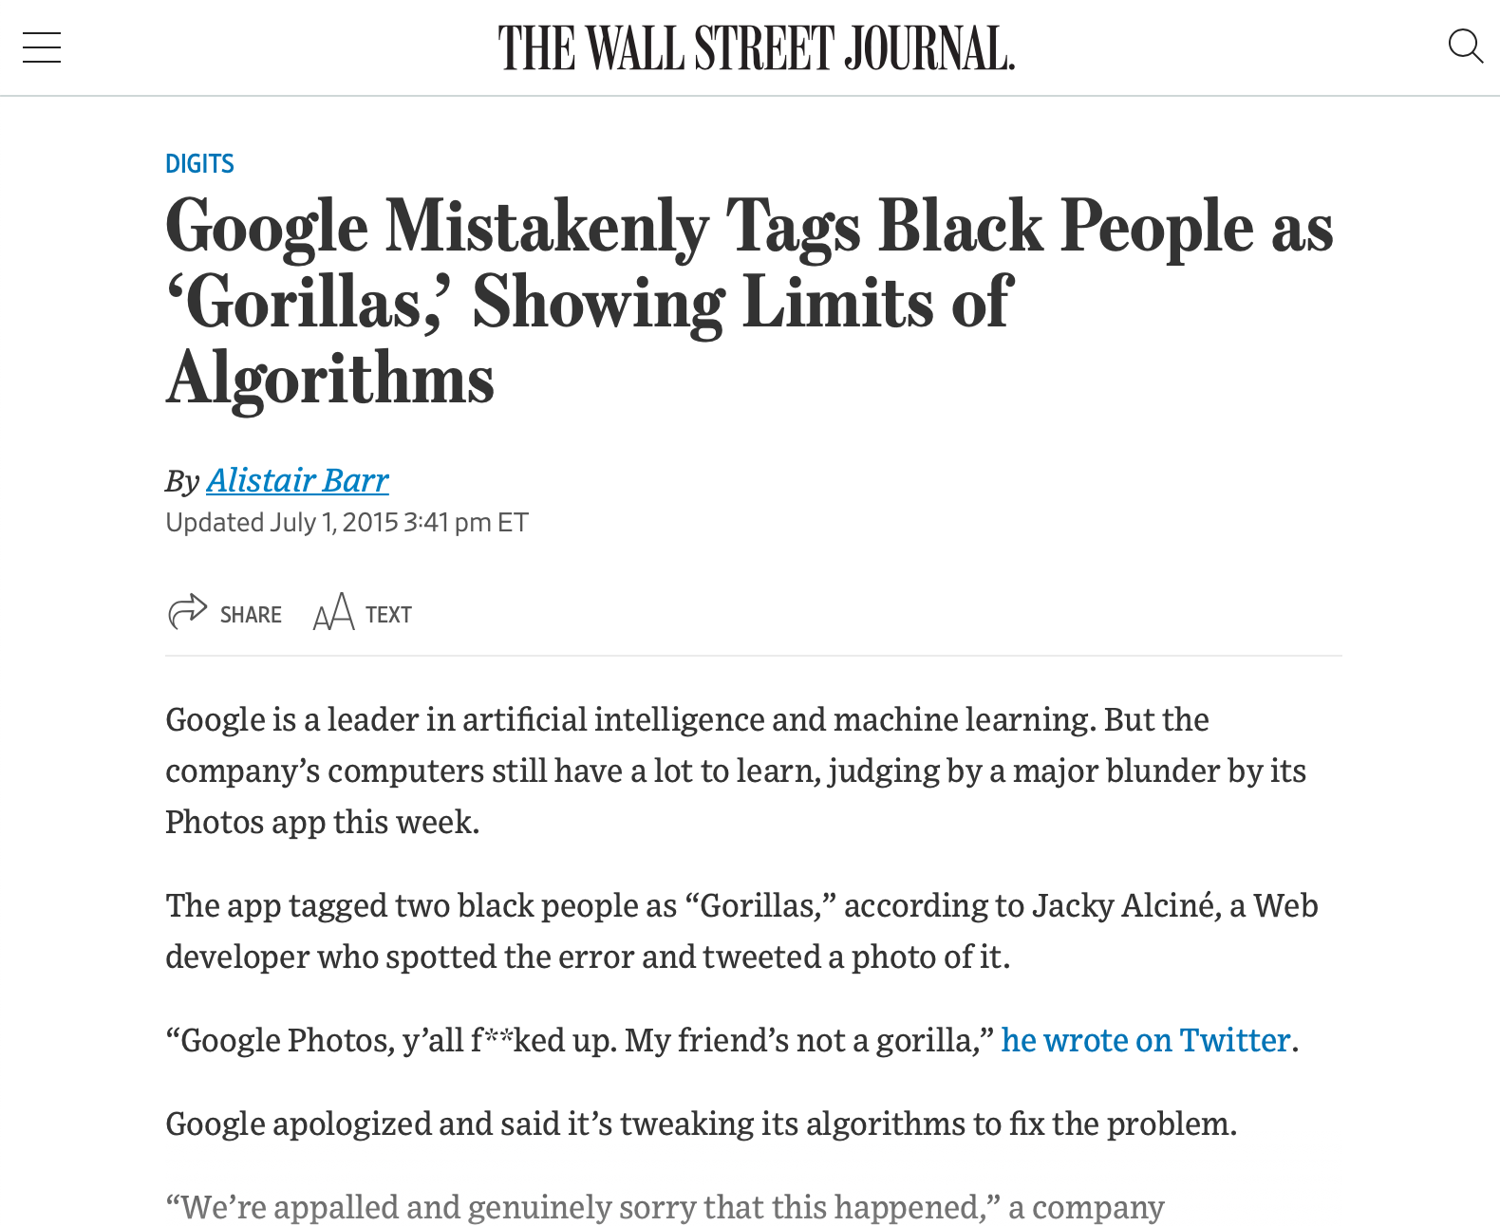
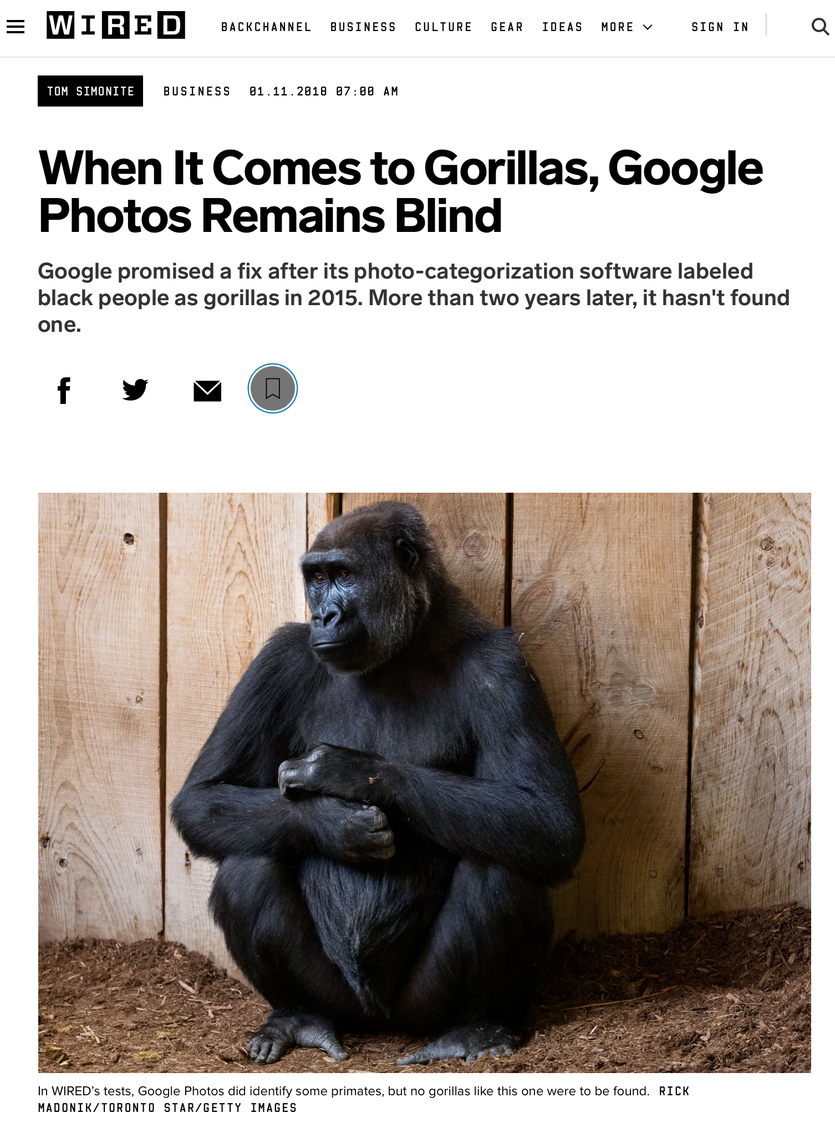
Bias is the Default
Example: Google Photos auto-tagging (2015)
https://www.wsj.com/articles/BL-DGB-42522
https://www.wired.com/story/when-it-comes-to-gorillas-google-photos-remains-blind/
Notes:
As a case example of bias as the default, consider this incident from 2015, when google released a new photo tagging feature in Google Photos, which was prone to misidentify black people in photographs as gorillas. How did this happen? Image recognition algorithm depend on being supplied a proper (complete) dataset - clearly an incomplete dataset, not representative of entire population. Why didn’t this come up in internal testing? To the extent that Google has a diverse development team today, that was much less true in 2015 - so nobody was trying it and finding this out, and the unconscious bias of the organization resulted in this product getting out. This was harmful both to users, and to Google’s reputation. Even today, this is not very well fixed - and is mostly side-stepped by not identifying any image as a gorilla. It’s useful to think of a case like this to set the tone for a conversation about diversity and inclusivity, but there are many more subtle biases in our software.

Slide 32

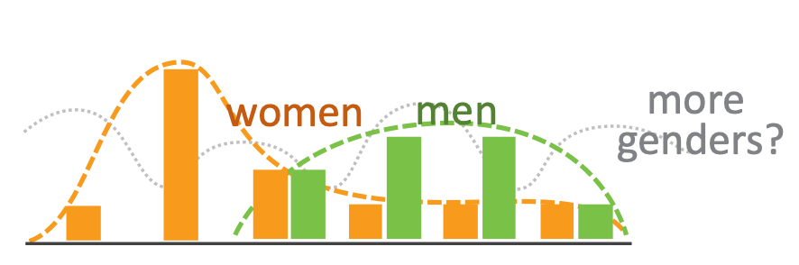
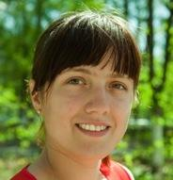
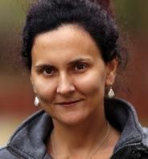

Unconscious Bias in Software
Does your software support a variety of users?
Aside from gender, race and ethnicity, how people interact with software varies, research has shown key inclusiveness facets:
Motivations
Information processing style
Computer self-efficacy
Risk averseness
Tech learning style
Idea: Perform cognitive walkthrough of our software, through the lens of someone else
Notes:
Aside from algorithmic biases, how does our unconscious bias translate into software that is not inclusive? Aside from gender, race and ethnicity, HOW people interact with software varies. Research has shown several key inclusiveness facets:
Motivations: do you learn new technologies in your free time, or only when you need to?
Information processing: do you gather all information comprehensively before trying to solve something, or do you prefer to gather information selectively as you go?
Computer self-efficacy: Do you feel confident about your ability to interact with a computer? If you struggle, do you blame yourself or the vendor?
Risk: will I make a mistake/spend more time than I have budgeted on this? If you try something that doesn’t work, does that change your attitudes towards that technology?
Tech learning style: do you favor process-oriented learning (go step-by-step) or tinkering?

Slide 33
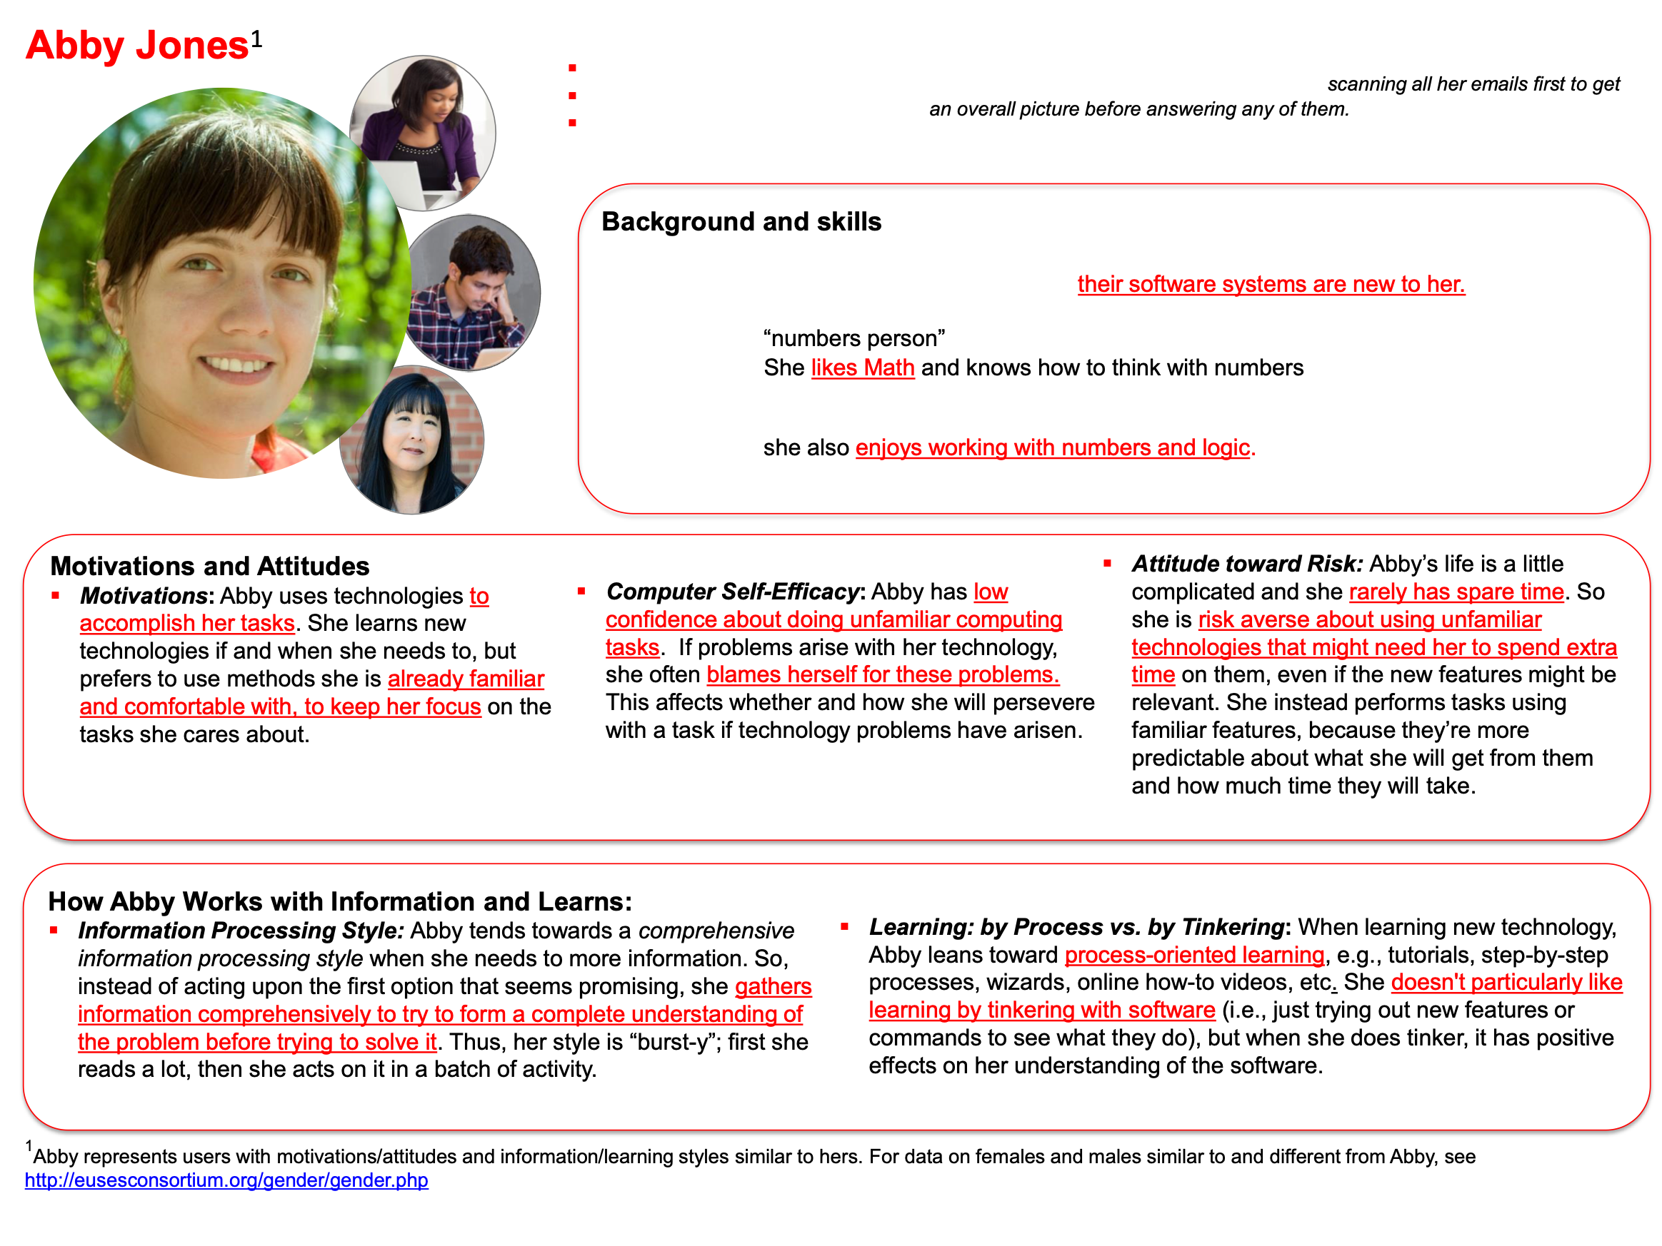
GenderMag: Gender Inclusiveness Magnifier
Persona-based evaluation
http://gendermag.org/foundations.php
Notes:
Persona-based evaluation allows for a “discount” usability evaluation. We don’t actually need to find real users who are different from us and get them to use our software (although that’s the best validation) - we can probably find lots of issues just by carefully walking through how someone like this persona would use our software (note: not actually persons that you know, not necessarily gendered)

Slide 34
GenderMag: Gender Inclusiveness Magnifier
Persona-based evaluation
Step through a use case for your tool, acting as the persona
Avoid jumping to conclusions - work in a group with multiple evaluators, take notes of issues as they occur
Compare to heuristic evaluation (week 6)
http://gendermag.org/Docs/GenderMagHandout-2020-0106-1649.pdf
Notes:
To perform a cognitive walkthrough, you and your team step through a single use case for your tool, acting as the persona.
For example: consider applying the Abby persona to evaluate an augmented reality application for navigating a book store…
Step by-step, note that “see map?” Is a difficult subgoal to form: abby’s motivation is to find science fiction books - why would they know that finding map is the right thing?
Then - note that “see bookstore map” is a “maybe” because Abby’s goal is “see map” but nothing says map! The developers meant ‘Browse off’ to mean to switch from a view where we are browsing a shelf to instead show the default, map view. If we’re not sure that Abby would know what to do [does abby tinker?], we note that, but then do it anyway.
Then, if we end up getting a map, we evaluate: does abby see progress to that subgoal of finding map? Maybe, maybe not - confusing. The facets of Abby’s persona allow us to imagine how another user, who doesn’t think like us, might interact with the same interface in a different way.

Slide 35
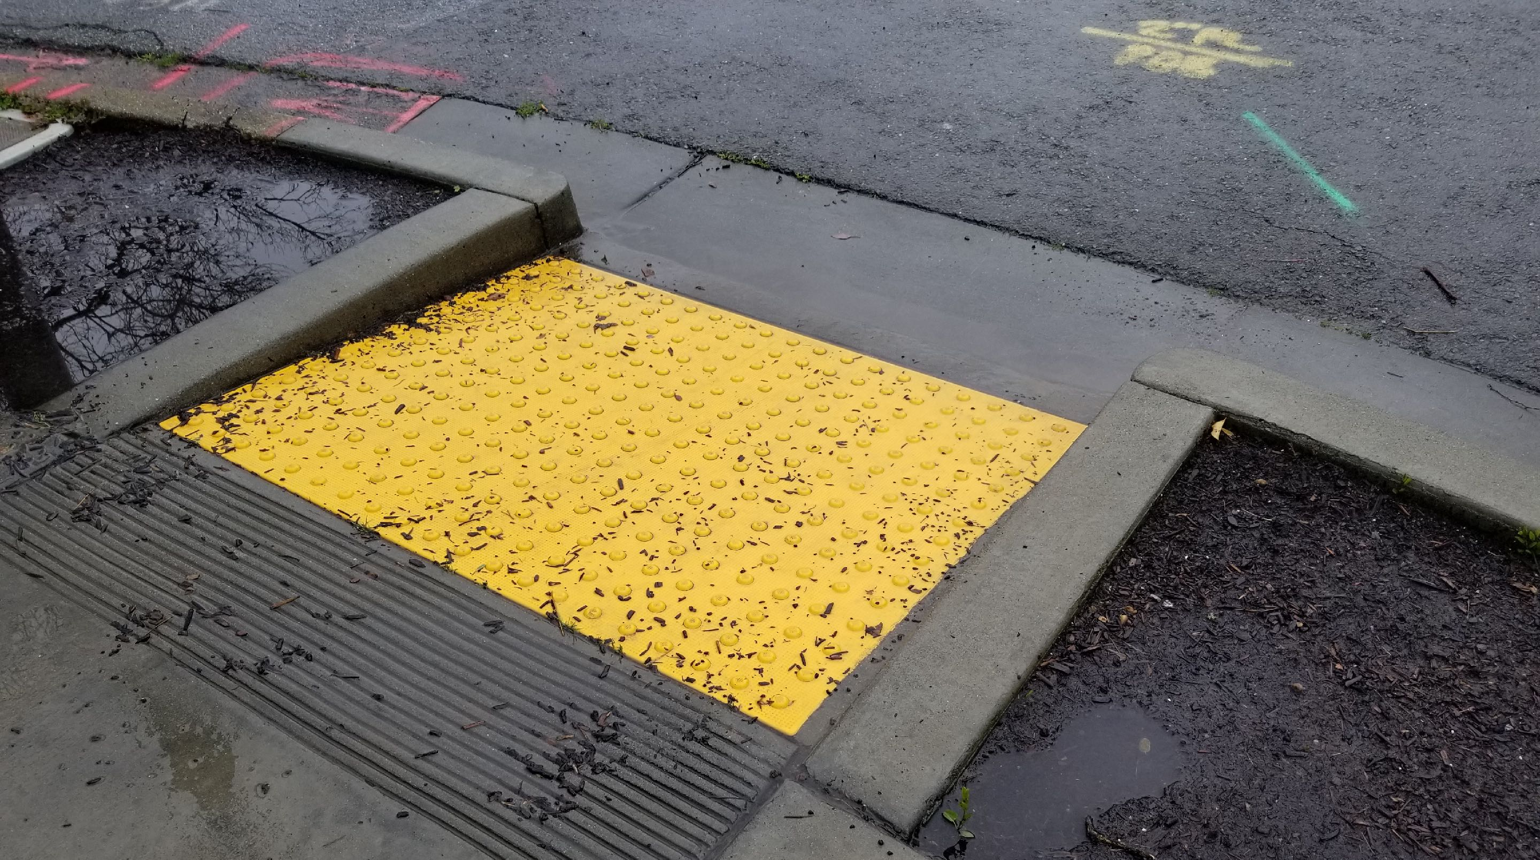
The Curb Cut Effect
“Curb Cuts” by Mike Gifford, CC BY-NC 2.0
Notes:
“The curb cut effect” describes broadly what happens when an inclusive design, built for one audience, benefits everyone. The effect gets its name from curb cuts - the small ramps between sidewalks and streets that were originally designed to allow people in wheelchairs to cross the street. However, this also benefits the old (who might struggle with a step), parents with strollers and workers making deliveries on hand trucks. For Example: Risk averse persona. Imagine that you are sloppy with vocabulary. “Browse off” vs “view map”. This is confusing. This is somethign that the risk averse individual might say “Wait what am I doing? I thought I was looking for a map. Oh I guess it’s turning off the browse feature?” This is like curb cuts though - it helps everyone, since, even if you weren’t particularly confused, it’s still a bit of a road bump.

Slide 36
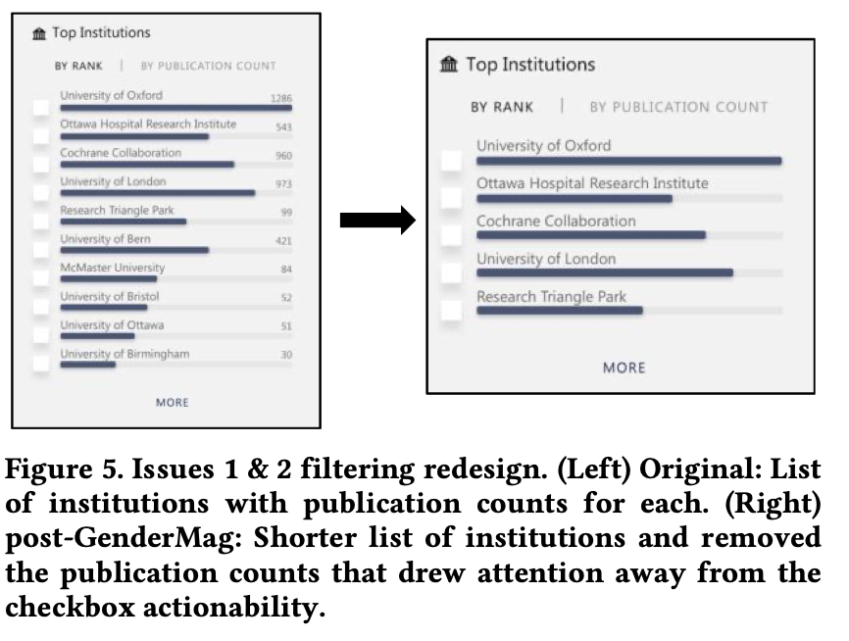
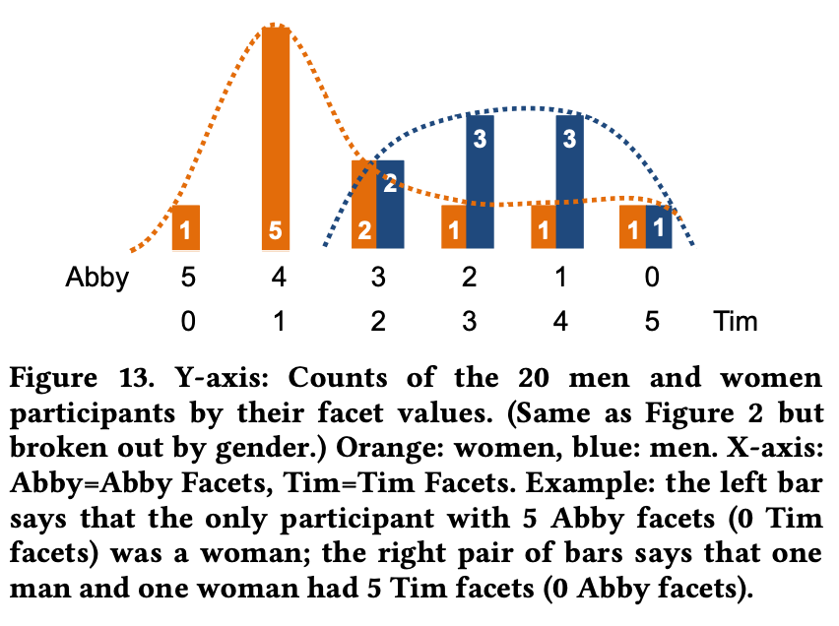
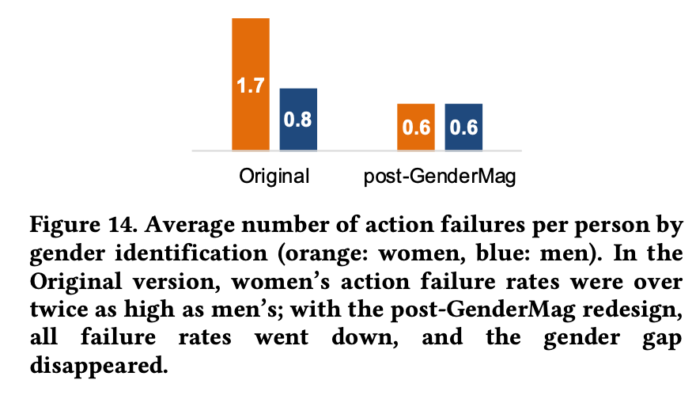
Usability Testing
Directly measuring the usability and inclusivity of our software
Observe real users interacting with your software - provide each user with a task, monitor their progress towards completing that task
Consider a diverse set of users that represent those who will use your software
Validate problems (and fixes) that you identify in cognitive walkthroughs
Example: applying GenderMag + usability testing for Microsoft Academic
ftp://ftp.cs.orst.edu/pub/burnett/chi19-GenderMag-findToFix.pdf
Notes:
The gold-standard for evaluating the efficacy of our software is usability testing.
Directly measure usability by monitoring task performance
Use diverse users, consider surveying based on facets - see figure in middle
Compare performance across interfaces (left figure, from MS academic prototype, can see it live)
Validate problems + fixes - and even find curb cut effect (Right figure)

Slide 37
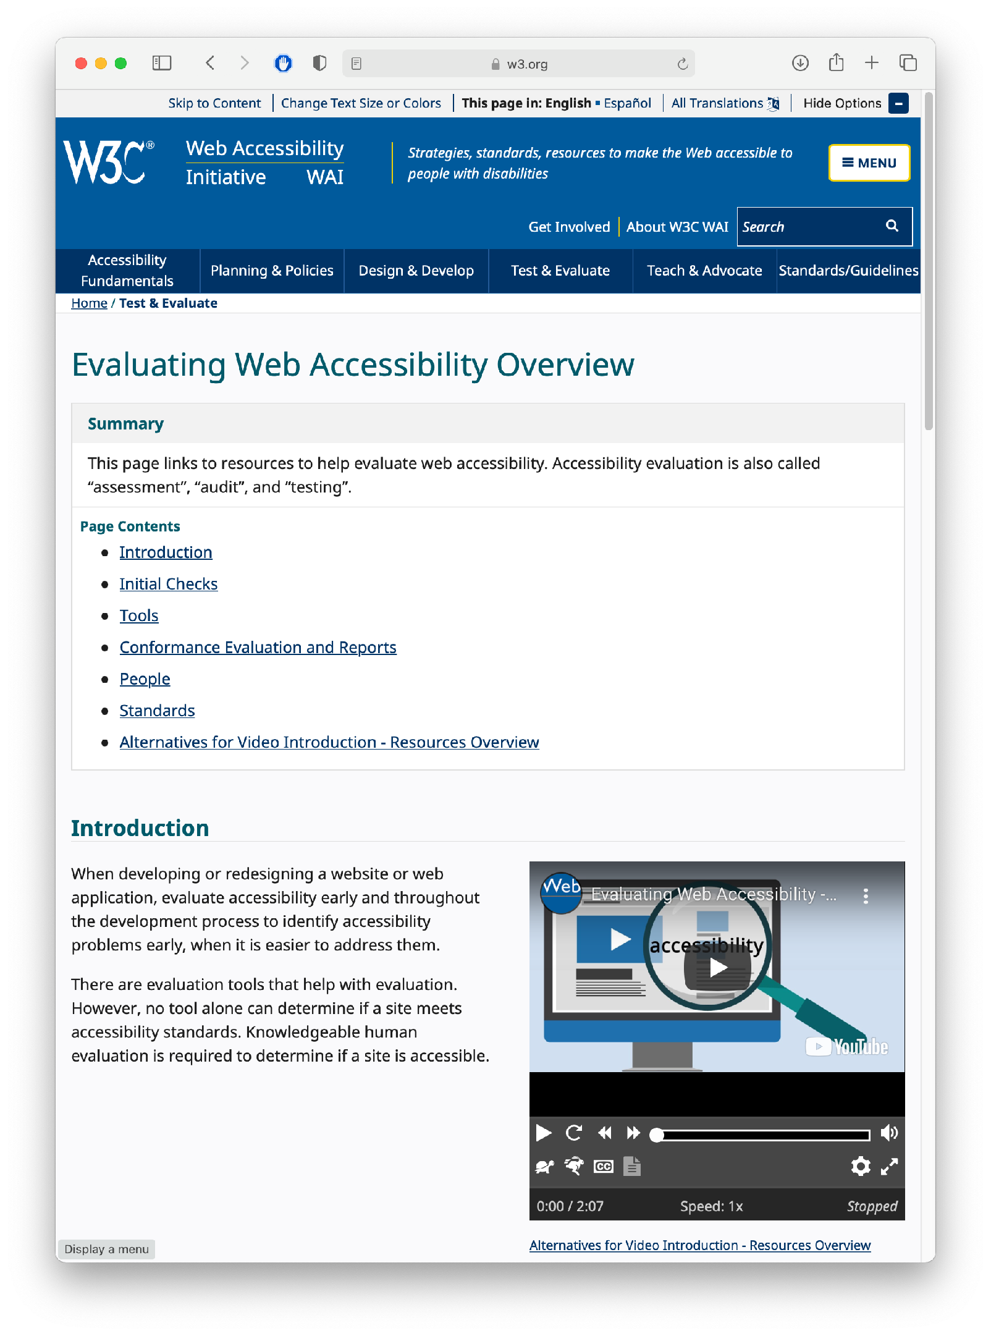
Usability Testing
Evaluating Accessibility
Check for conformance with requirements of standards
Involve users in your evaluation - simply “meeting a standard” does not guarantee accessibility
https://www.w3.org/WAI/test-evaluate/
Notes:
Evaluating accessibility is another form of usability testing. We can begin by checking (ourselves) the conformance of our application with the requirements laid out by standards, like the W3C’s WCAG (Web Content Accessibility Guidelines) standards. Simply meeting a standard doesn’t mean that it’s usable, and simply having one disabled person say that it works for them doesn’t mean that it’s usable - still conduct a broad user study for best results.

Slide 38
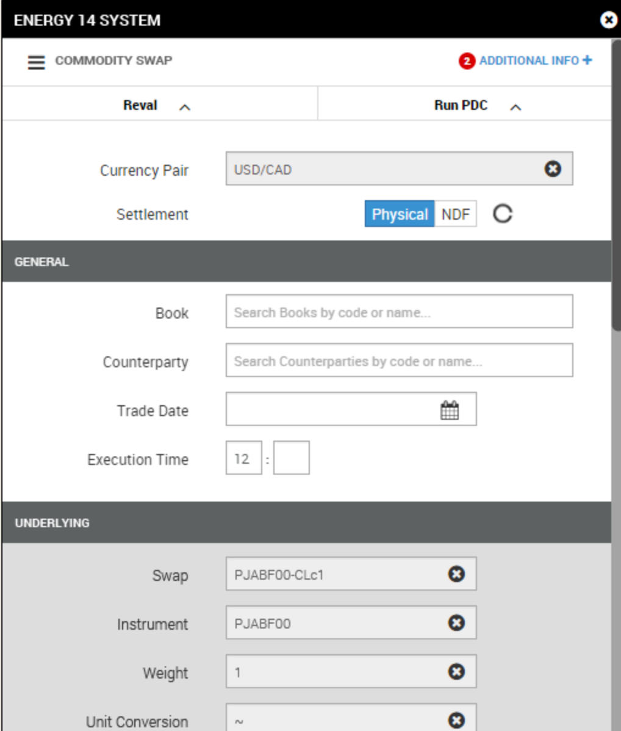
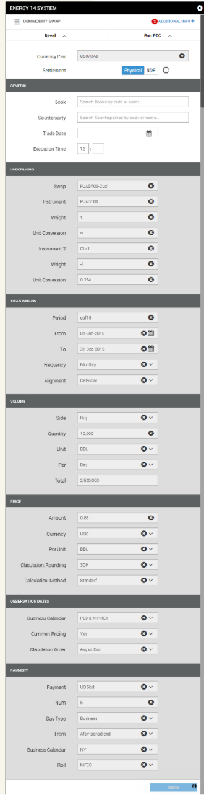
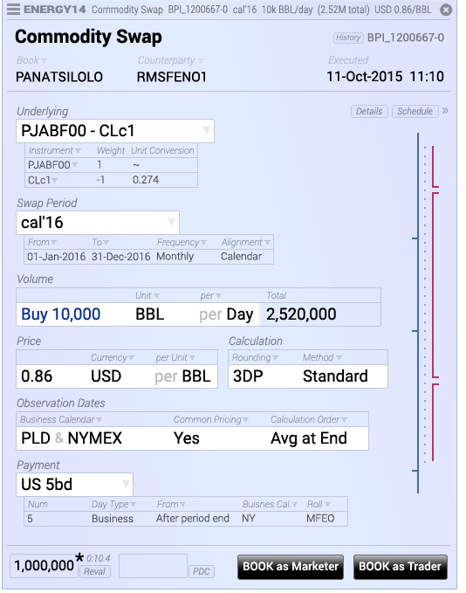
Usability Testing
For some software, we are nothing like our users
Commodity swap screens & story © 2016, Brad Paley
http://didi.co/consulting/
Notes:
User studies are extremely useful both when trying to build inclusive software that works for lots of users, and also extremely niche software that solves a specialized task. This is for energy commodities swap, a task that commodities traders might do many times an hour. Left interface seems “right” following Nielsen heuristics. But, the form needs to be filled out extremely fast - and it doesn’t even fit on a page! Right interface is the re-design, compresses data, meets users mental models. Better that you do this kind of testing before declaring your software “complete” so that you don’t lose a contract and get fired.

Slide 39
Usability Testing in Continuous Development
A/B Testing
Ways to test new features for usability, popularity, performance without a focus group
Show 50% of your site visitors version A, 50% version B, collect metrics on each, decide which is better
Notes:
In a continuous development environment, we can do live user studies with A/B testing…

Slide 40
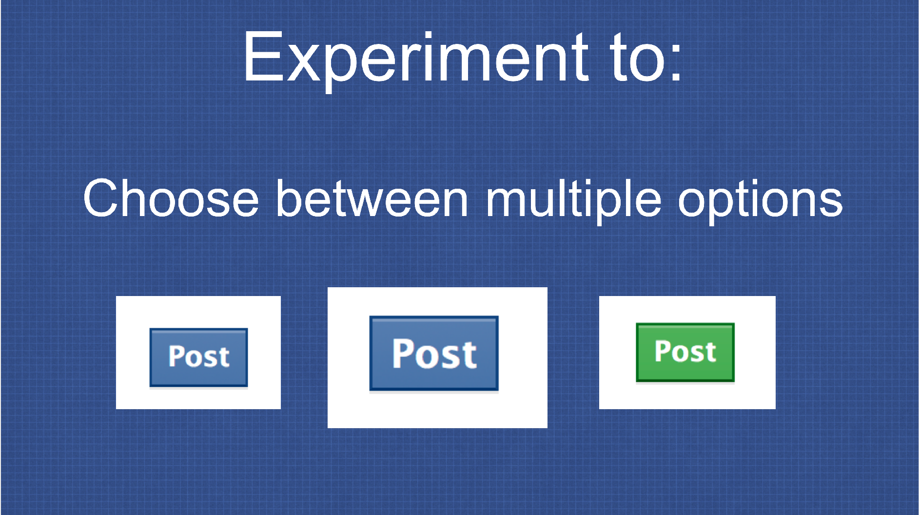
Usability Testing in Continuous Development
A/B Testing: PlanOut from Facebook (“N=10⁹ user study”)
Used to test advertising strategies (and Facebook functionality)
Segment audience and define KPIs, collect results
https://github.com/facebook/planout
https://www.slideshare.net/optimizely/opti-con-2014-automated-experimentation-at-scale
Notes:
Facebook performs these experiments constantly, and has even constructed an open source tool for doing so.
Basically doing a psychology experiment - try to avoid being evil (“show users sad posts, does that make them sad?”). Key feature: segment audience (think about diverse users) and collect results

Slide 41
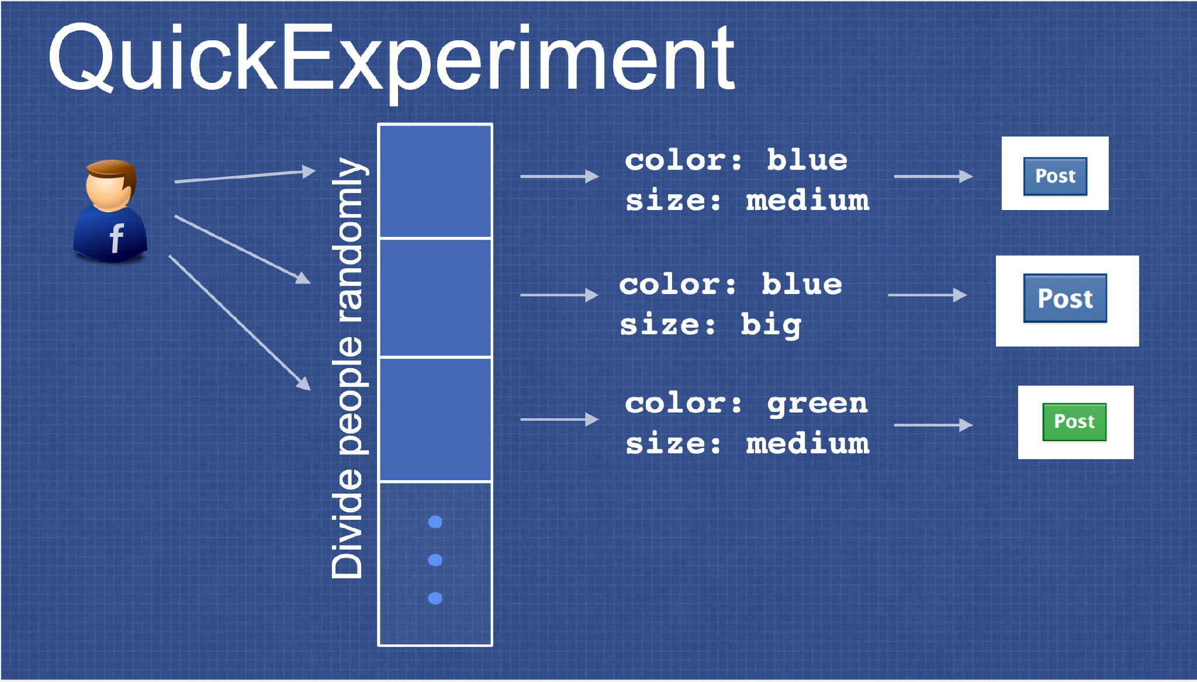
Usability Testing in Continuous Development
A/B Testing: PlanOut from Facebook (“N=10⁹ user study”)
https://github.com/facebook/planout
https://www.slideshare.net/optimizely/opti-con-2014-automated-experimentation-at-scale
Notes:
Example for a quick experiment - divide people randomly, show different post buttons

Slide 42
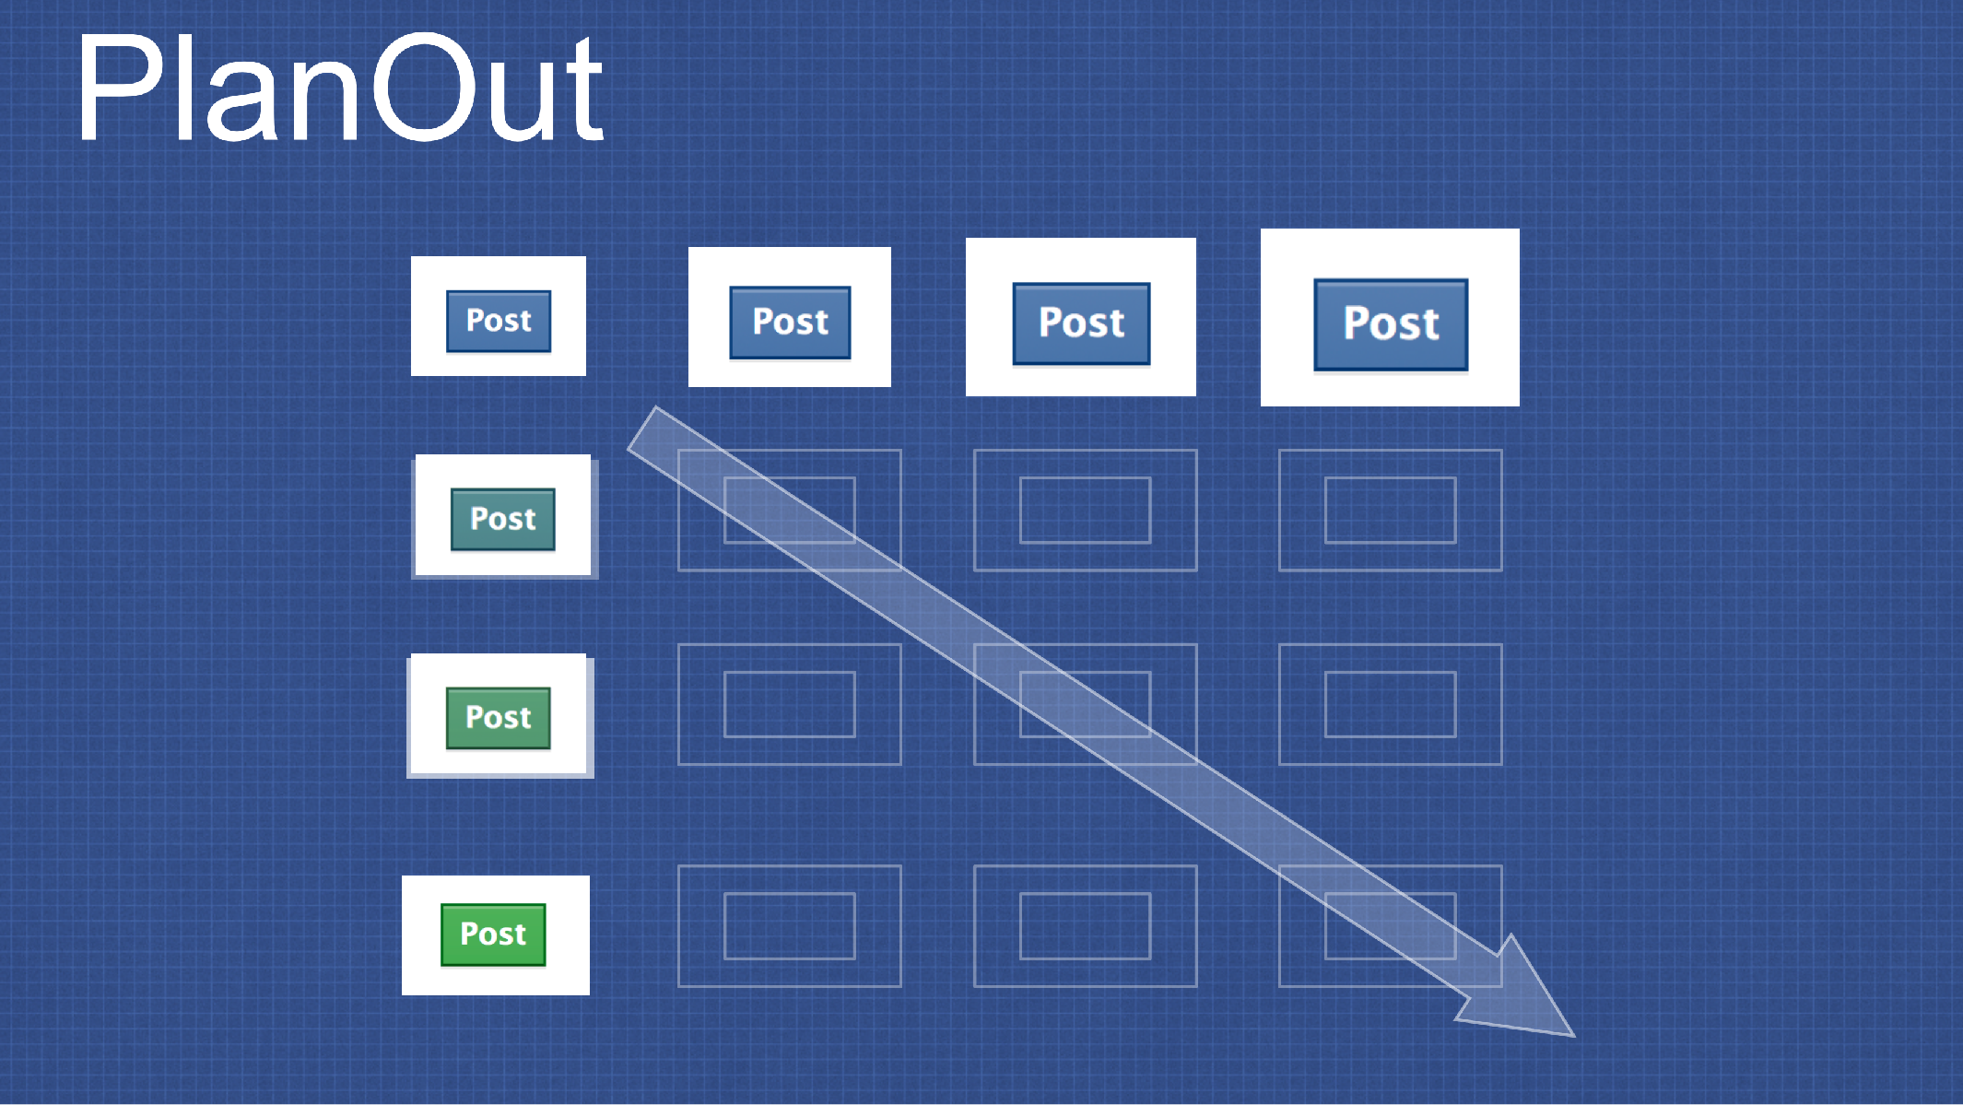
Usability Testing in Continuous Development
A/B Testing: PlanOut from Facebook (“N=10⁹ user study”)
https://github.com/facebook/planout
https://www.slideshare.net/optimizely/opti-con-2014-automated-experimentation-at-scale
Notes:
Can also consider gradients of options - say, controlling for size, and color

Slide 43
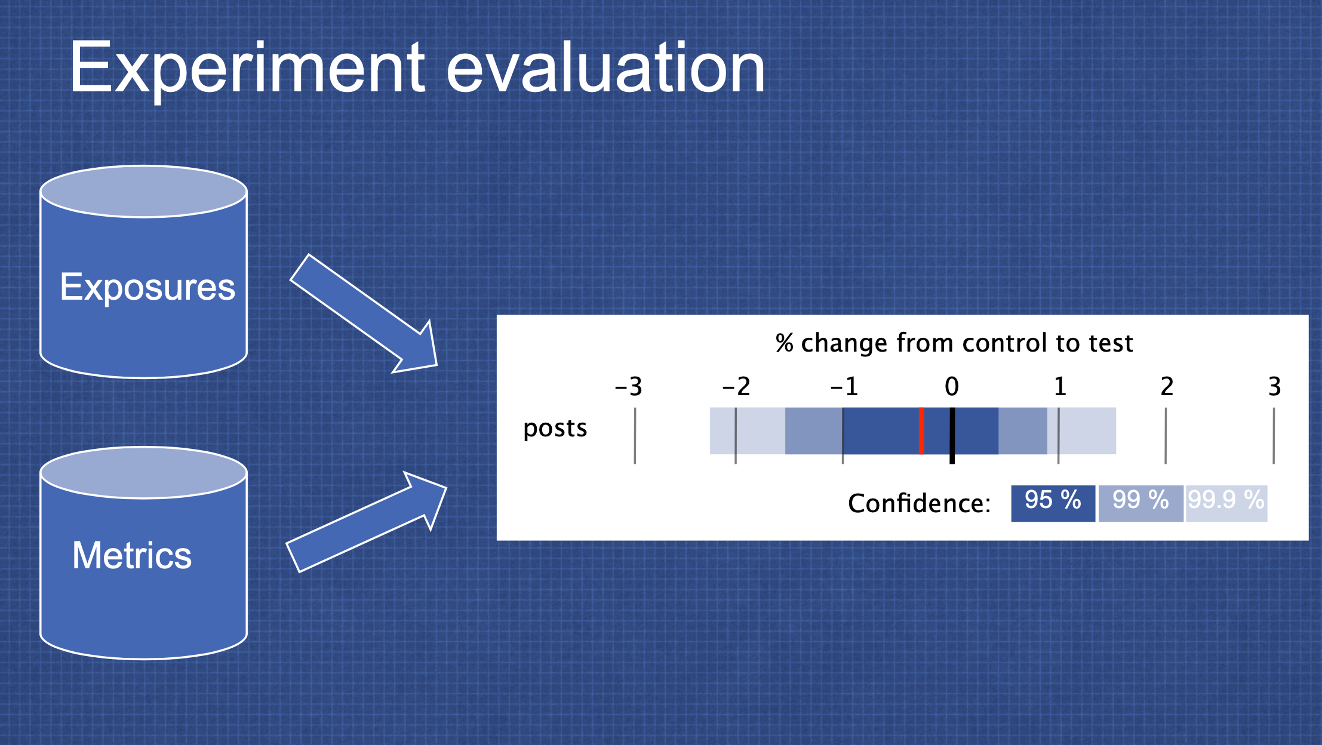
Usability Testing in Continuous Development
A/B Testing: PlanOut from Facebook (“N=10⁹ user study”)
https://github.com/facebook/planout
https://www.slideshare.net/optimizely/opti-con-2014-automated-experimentation-at-scale
Notes:
Then, take exposures + metrics, evaluate your KPI

Slide 44
Engineering Equitable Software
Key takeaways
With great power comes great responsibility
Anticipate the unanticipated consequences of your software
Limiting the accessibility of software might save money in the short term, but cost much more in the long term
Form a diverse development team, and involve a diverse group of users to validate your software
Notes:
There is an imbalance of power between those who write software and those who are subject to the implications of that software, sometimes at a disadvantage. As software engineers, it is vital that we anticipate the unanticipated - how might our software be inadvertently causing harm. Even if we are not building radiation therapy machines that can literally kill our users, we are still in a position of power to create software that is inclusive, and equally accessible to users who are not like us. Limiting the accessibility of our software (for instance, not adding support for screen readers, or not fixing the kinds of inclusivity bugs found by gendermag) might save money in the short term, but will likely end up costing much more in the long term. That you are taking this class, and still listening to this lecture likely means that you aspire to become an exceptional engineer - solve problems, and drive positive outcomes for a broad base of people. To do so, hopefully you are now aware of some strategies to consider how the software you build will be impact humanity, hopefully, for the better.

